Slide 1
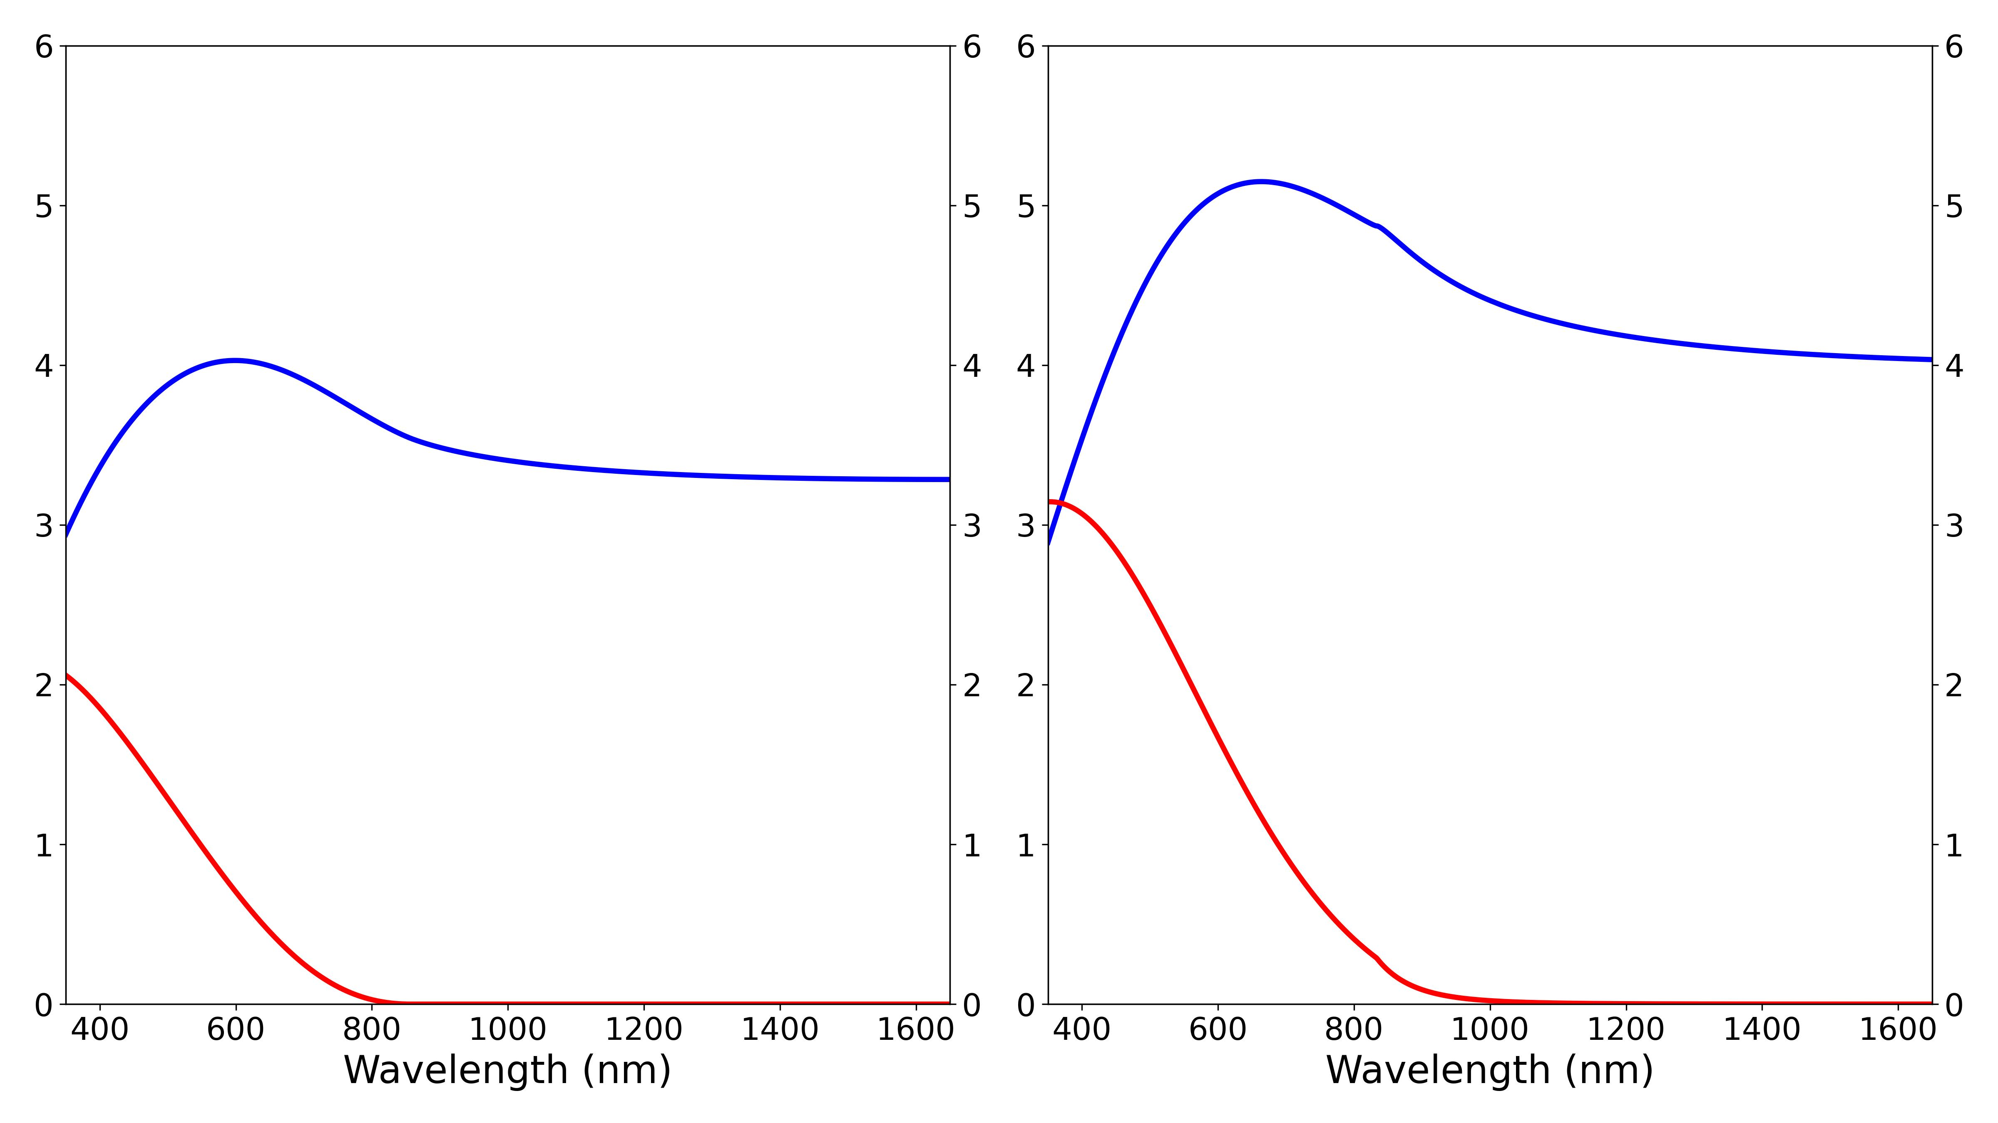
Amorphous Sb₂Se₃
Refractive index n
Extinction coefficient k
Crystalline Sb₂Se₃
Refractive index n
Extinction coefficient k

Slide 2
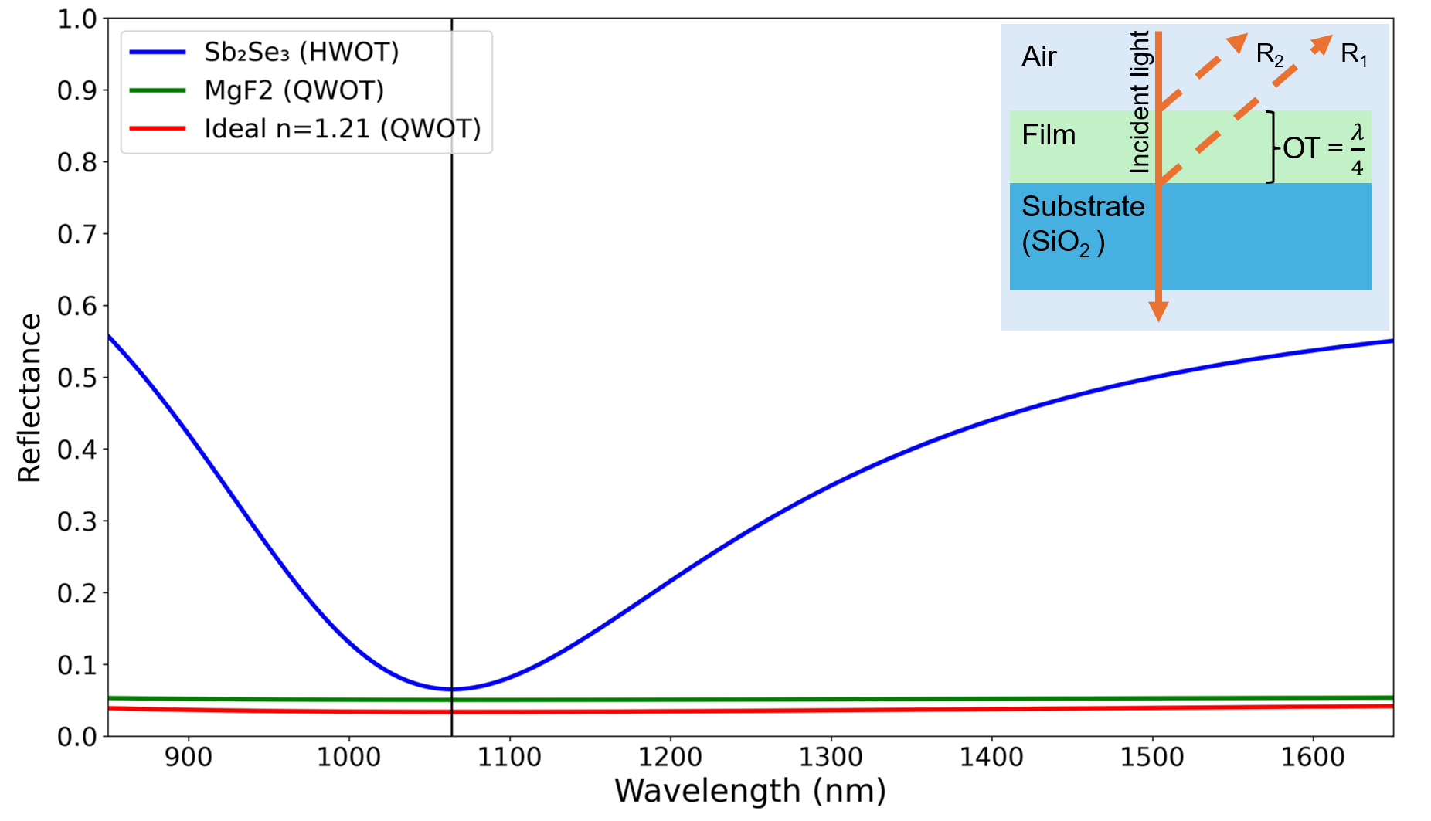

Slide 3
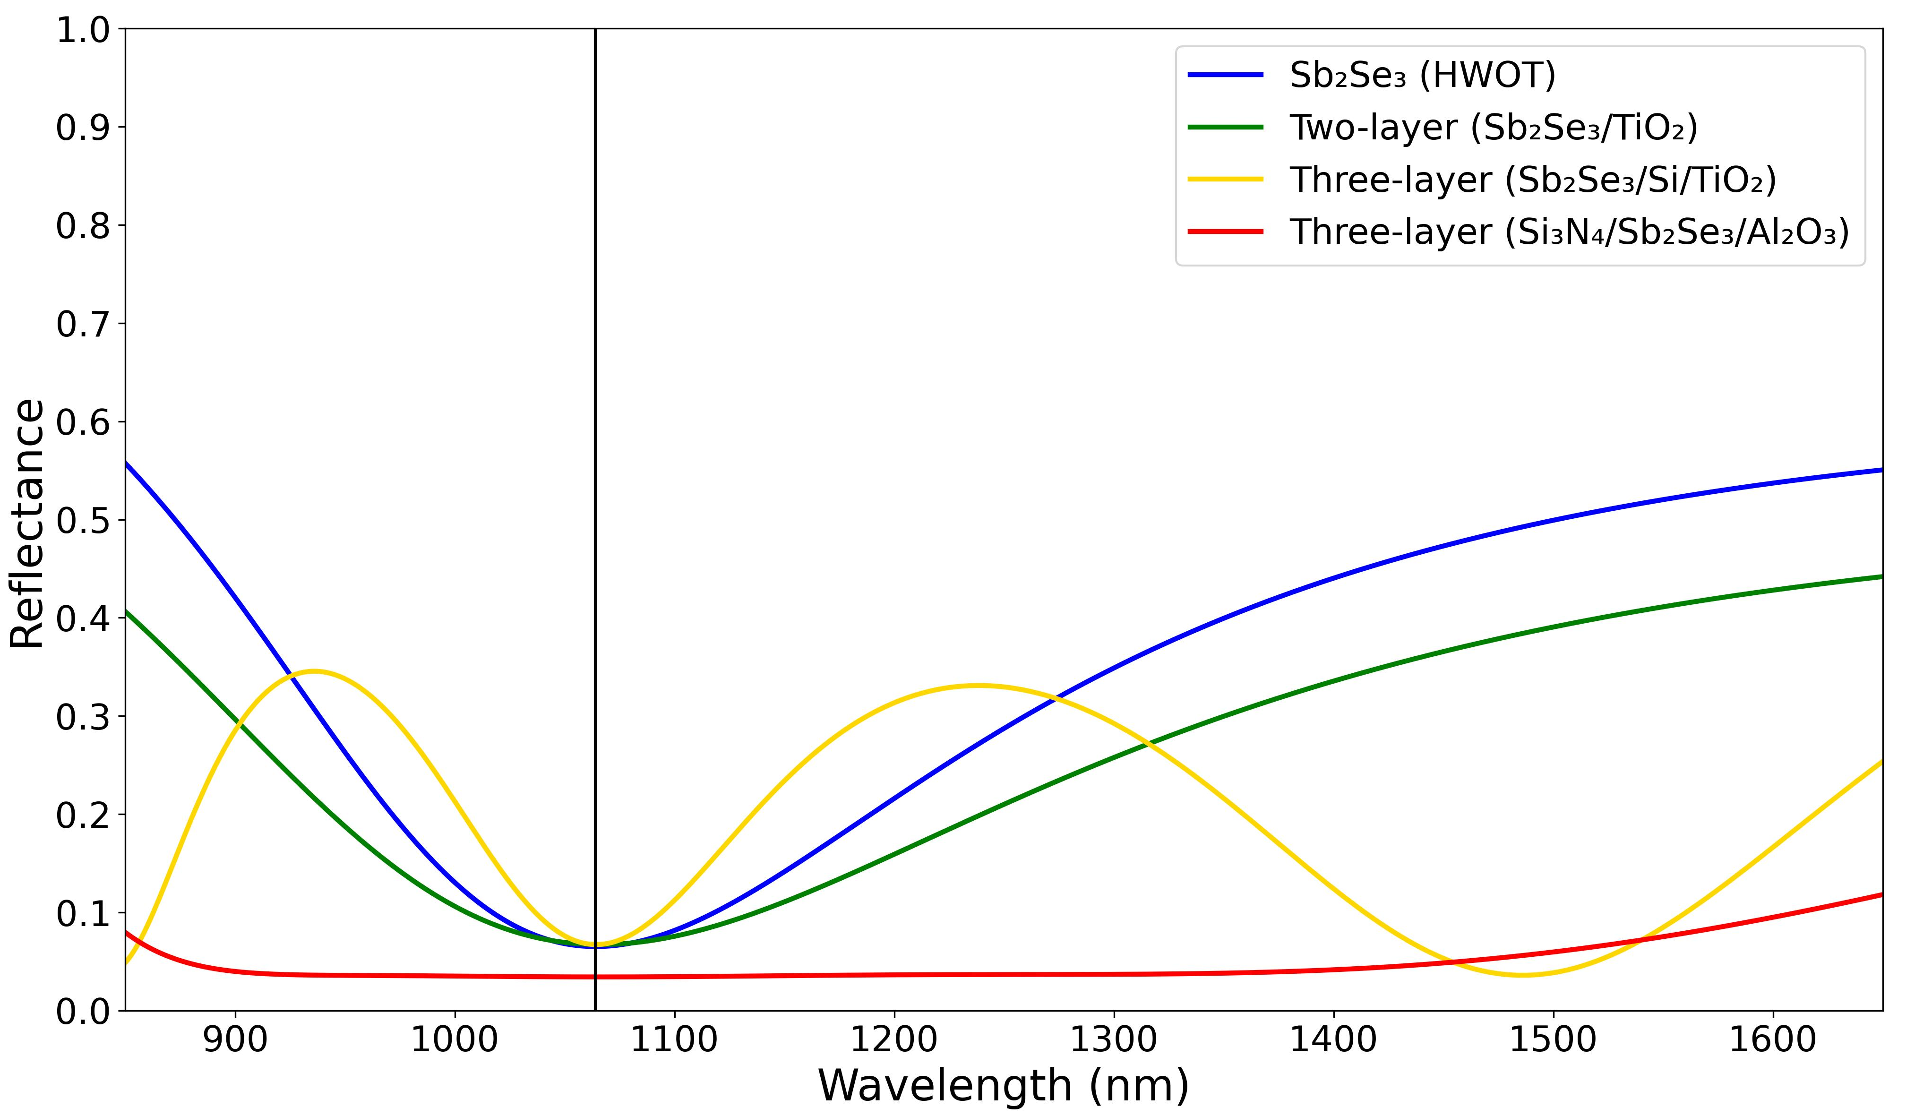
(a) Reflectance of each design
Two-layer design
Three-layer #1
Three-layer #2
TiO₂ = 115.2 nm
Al₂O₃ = 164.6 nm
TiO₂ = 115.2 nm
Si = 149.6 nm
Sb₂Se₃ = 157.9 nm
Sb₂Se₃ = 78.9 nm
Sb₂Se₃ = 78.9 nm
Si₃N₄ = 133.2 nm
Substrate
Substrate
Substrate
(b) Thickness of each design

Slide 4
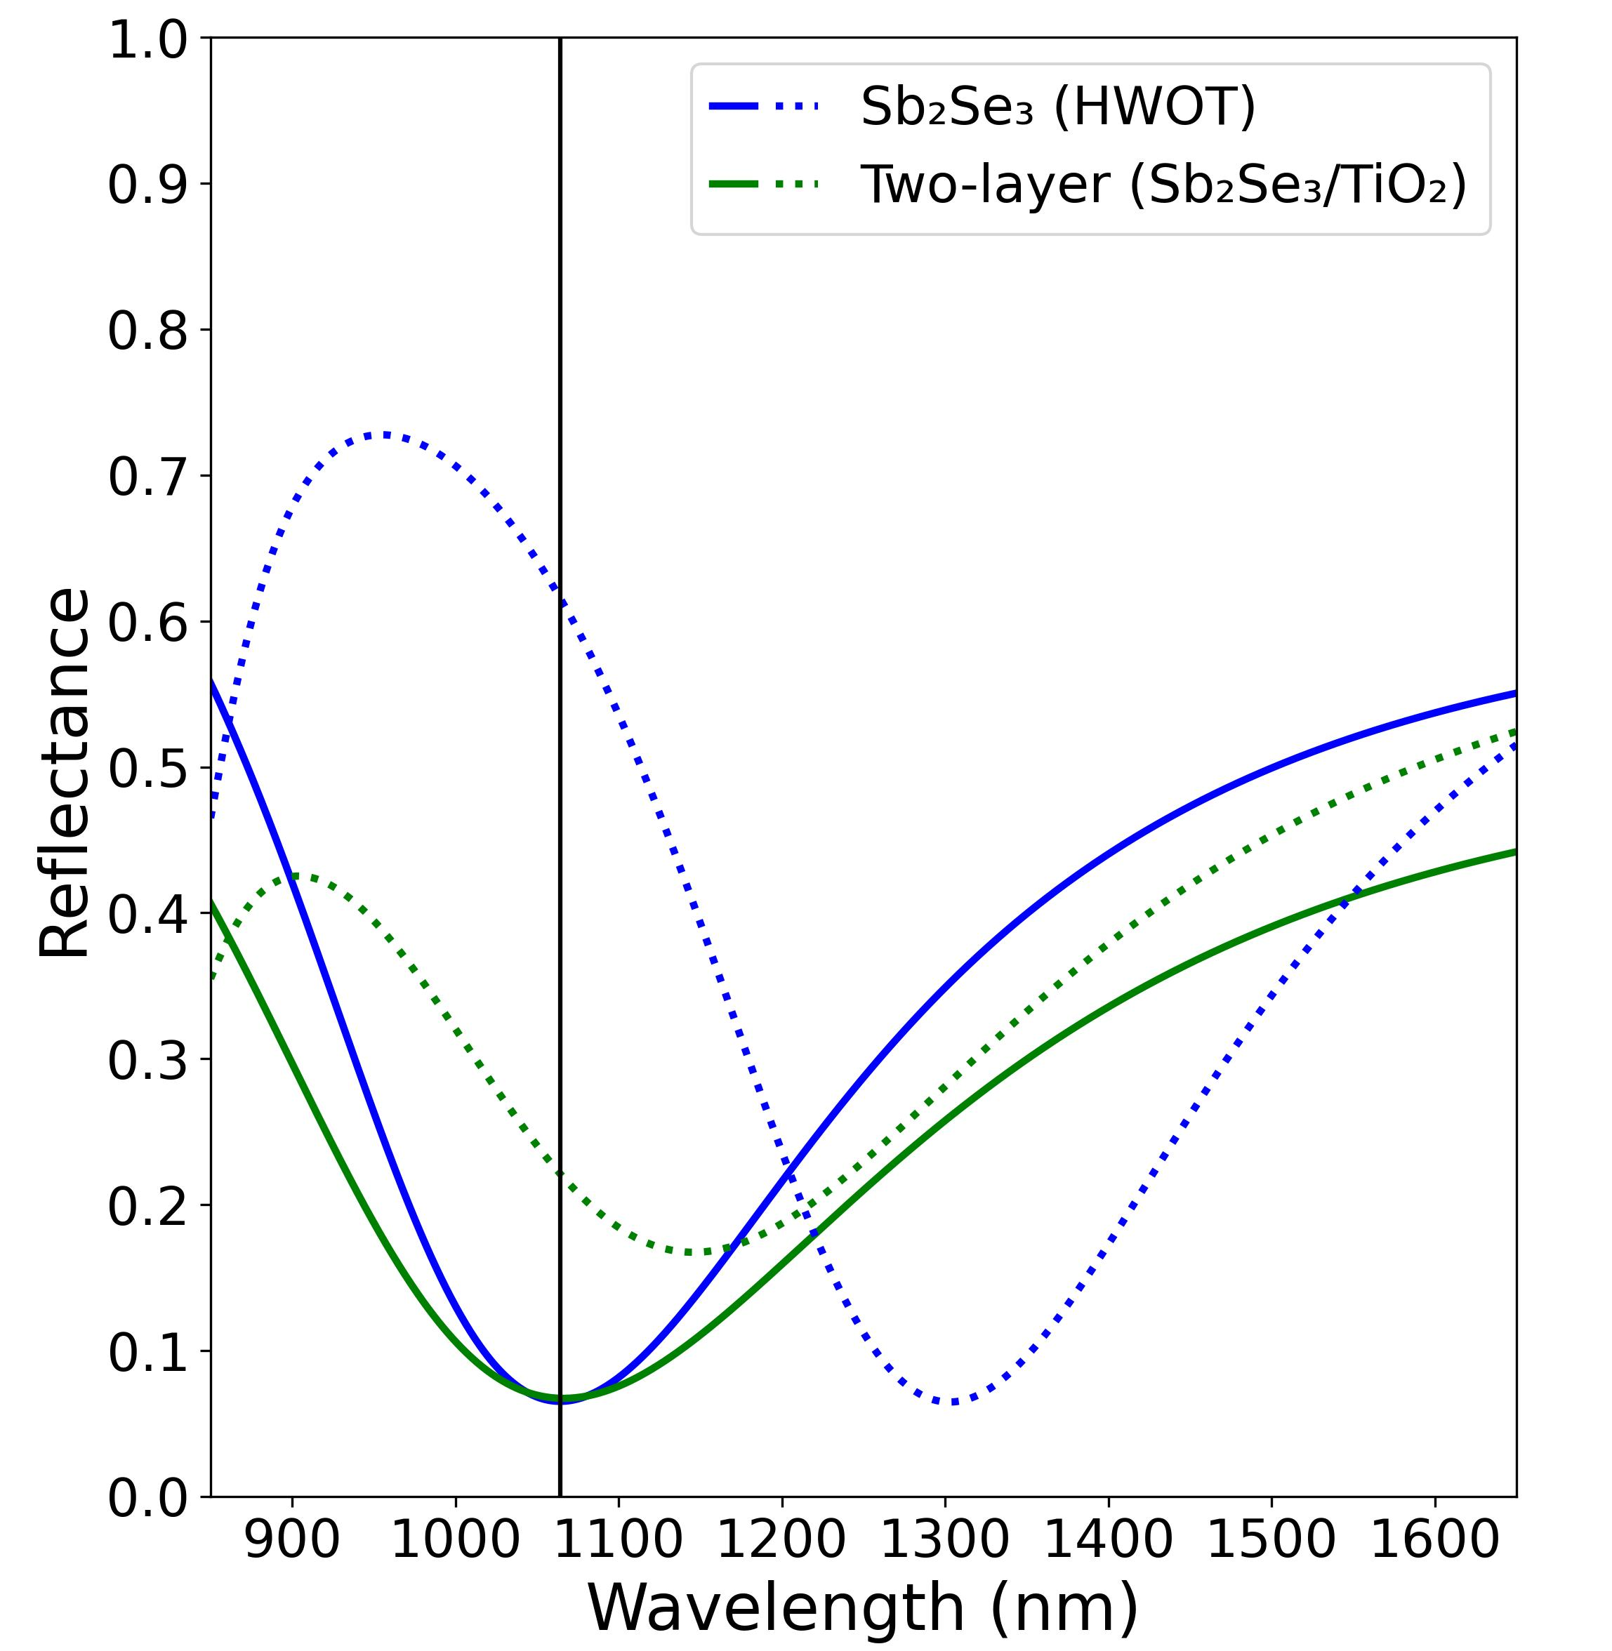
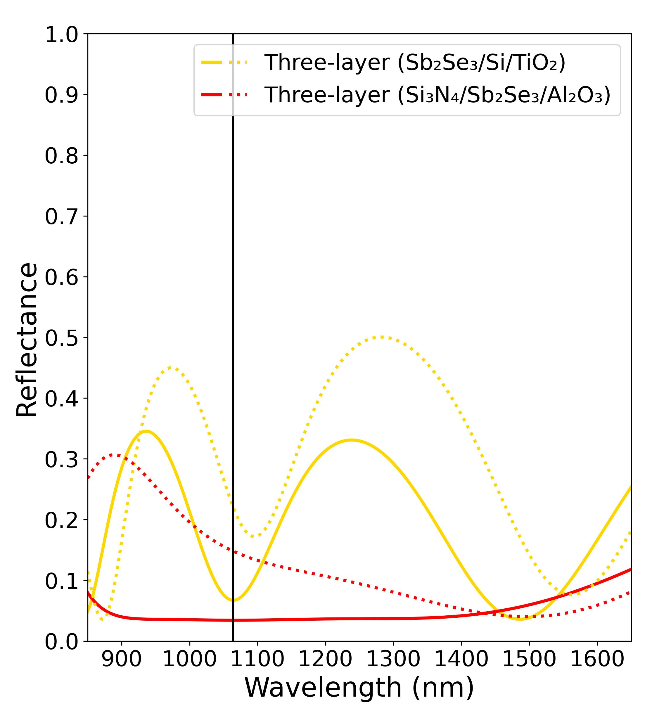
(a) Reflectance of single and two-layer designs
(b) Reflectance of different three-layer designs

Slide 5
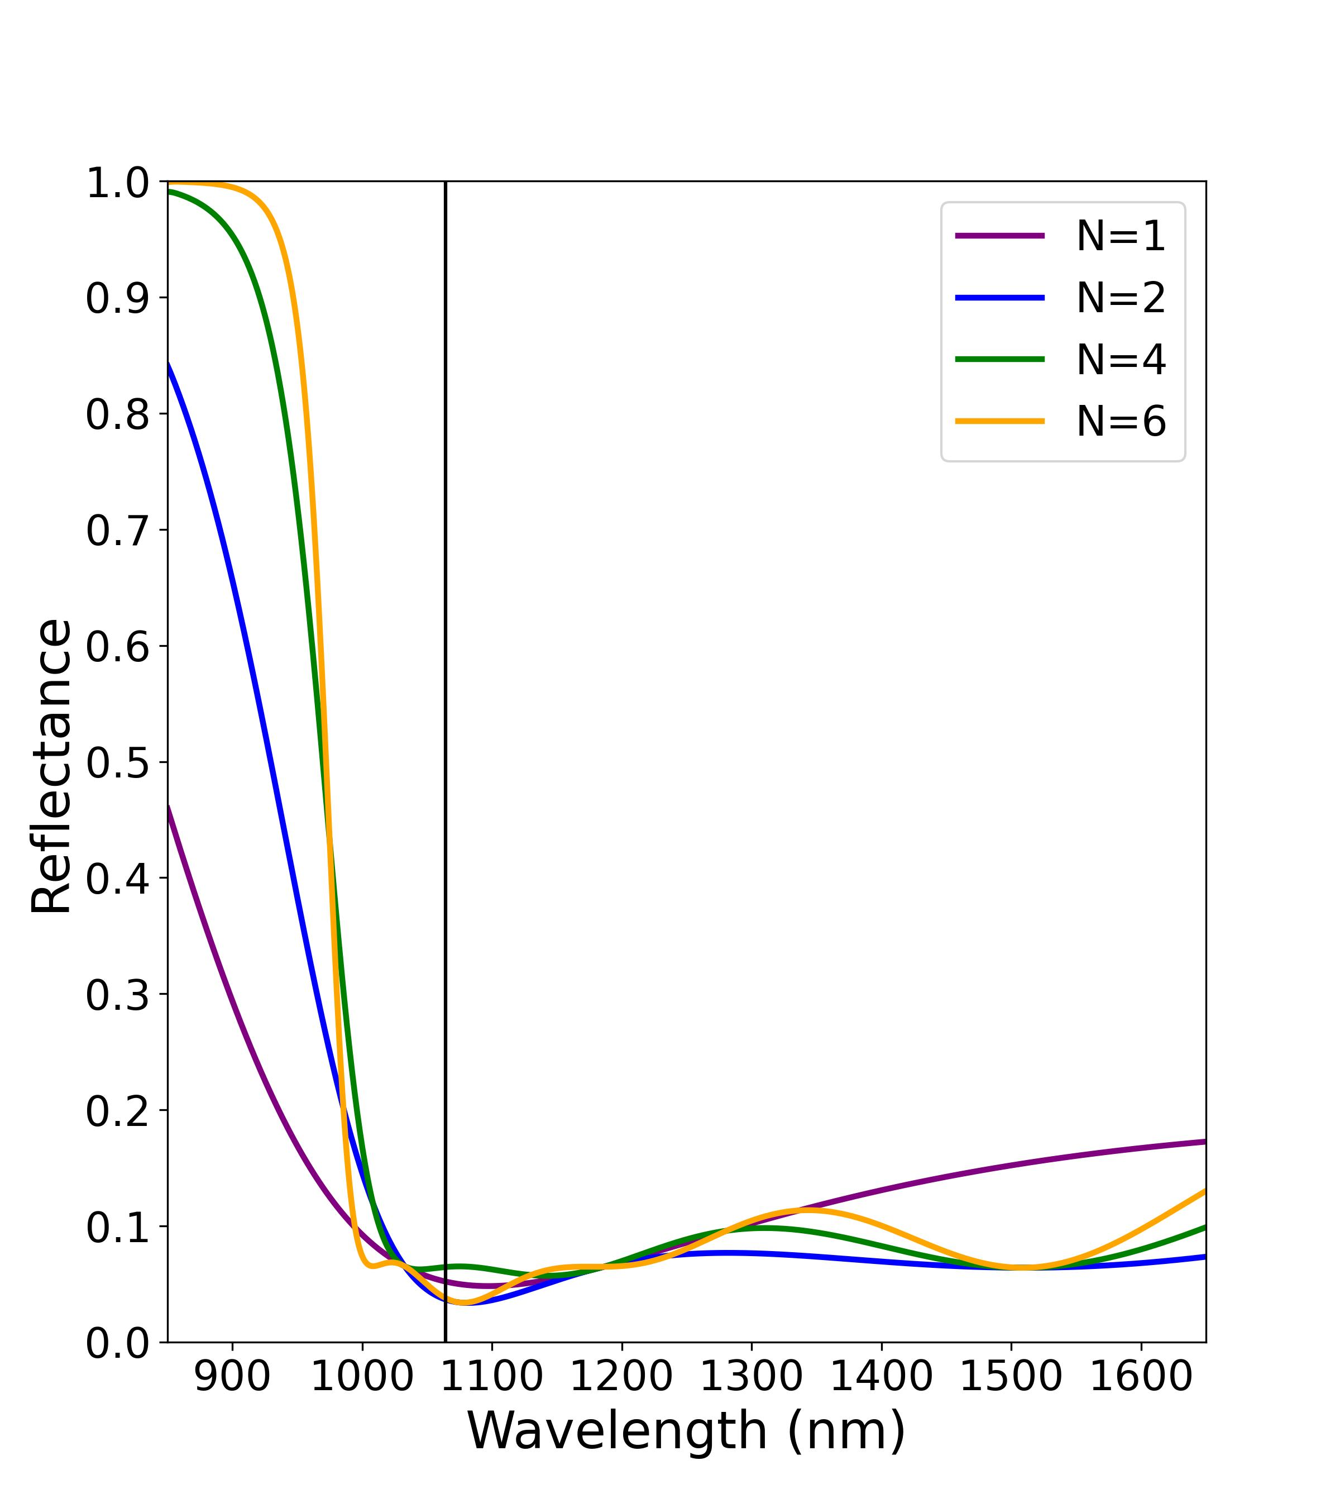
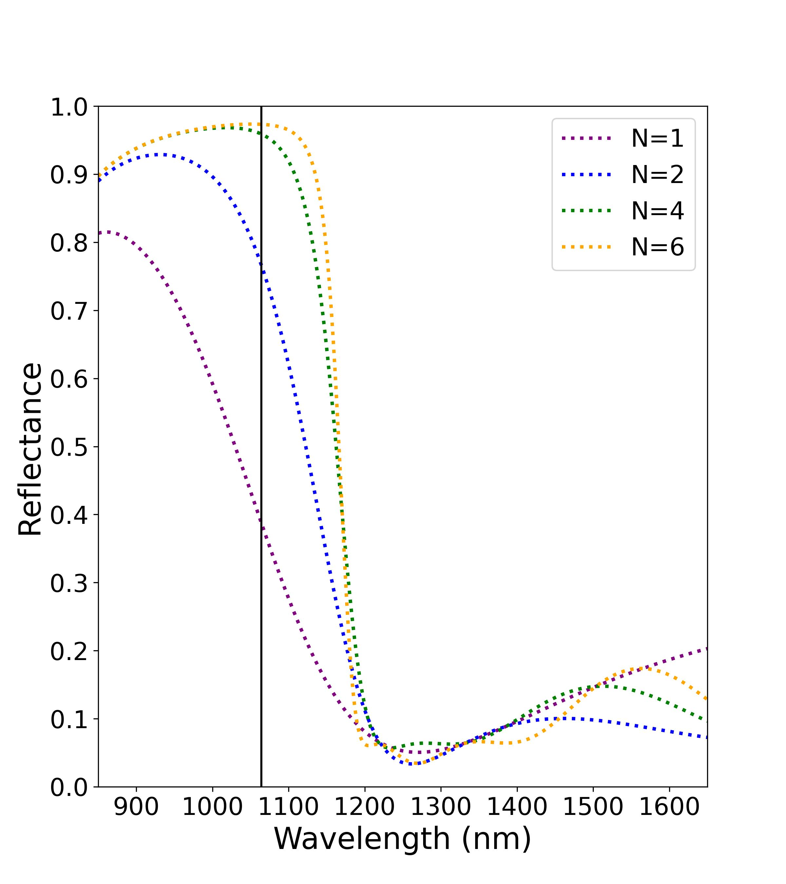
(a) Amorphous phase
(b) Crystalline phase

Slide 6
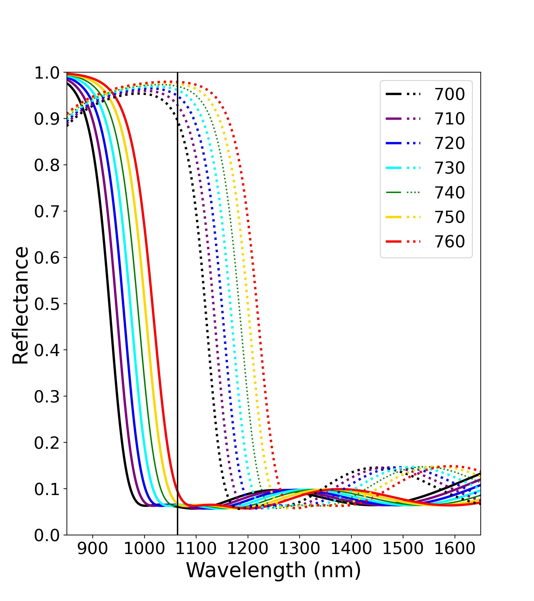
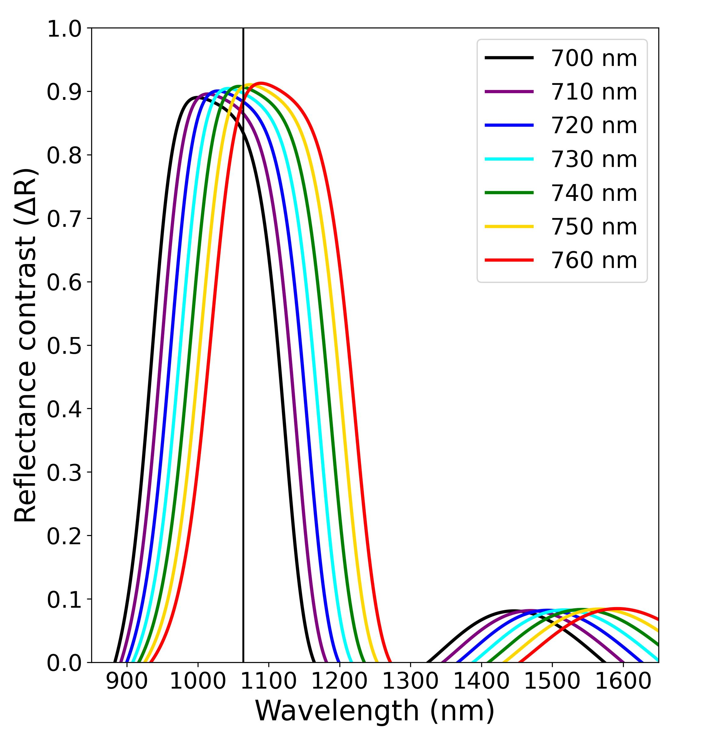
(a) Reflectance of N=4 designs
(b) Reflectance contrast of N=4 designs
Long-pass edge filter
Short-pass edge filter
24.3 nm
Sb₂Se₃
MgF₂
134.0 nm
MgF₂
A single unit cell (N= 1)
Sb₂Se₃
Sb₂Se₃
MgF₂
Sb₂Se₃
MgF₂
MgF₂
* All edge filters shown in (a) and (b) have N = 4
Sb₂Se₃
Sb₂Se₃
MgF₂
Substrate
Substrate
(c) Thickness of long-pass and short-pass edge-filter design (λ0 = 740 nm)

Slide 7
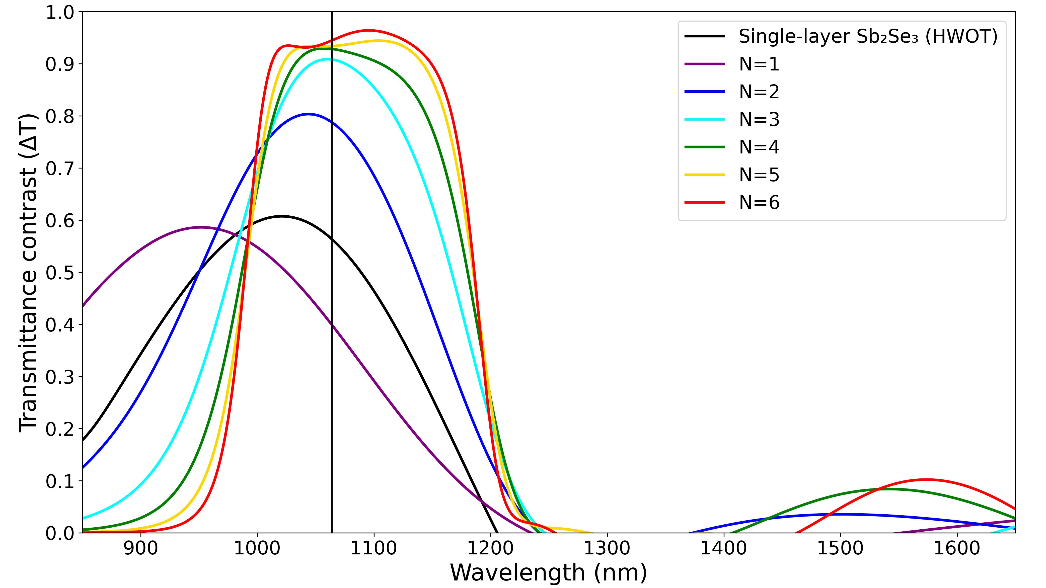

Slide 8
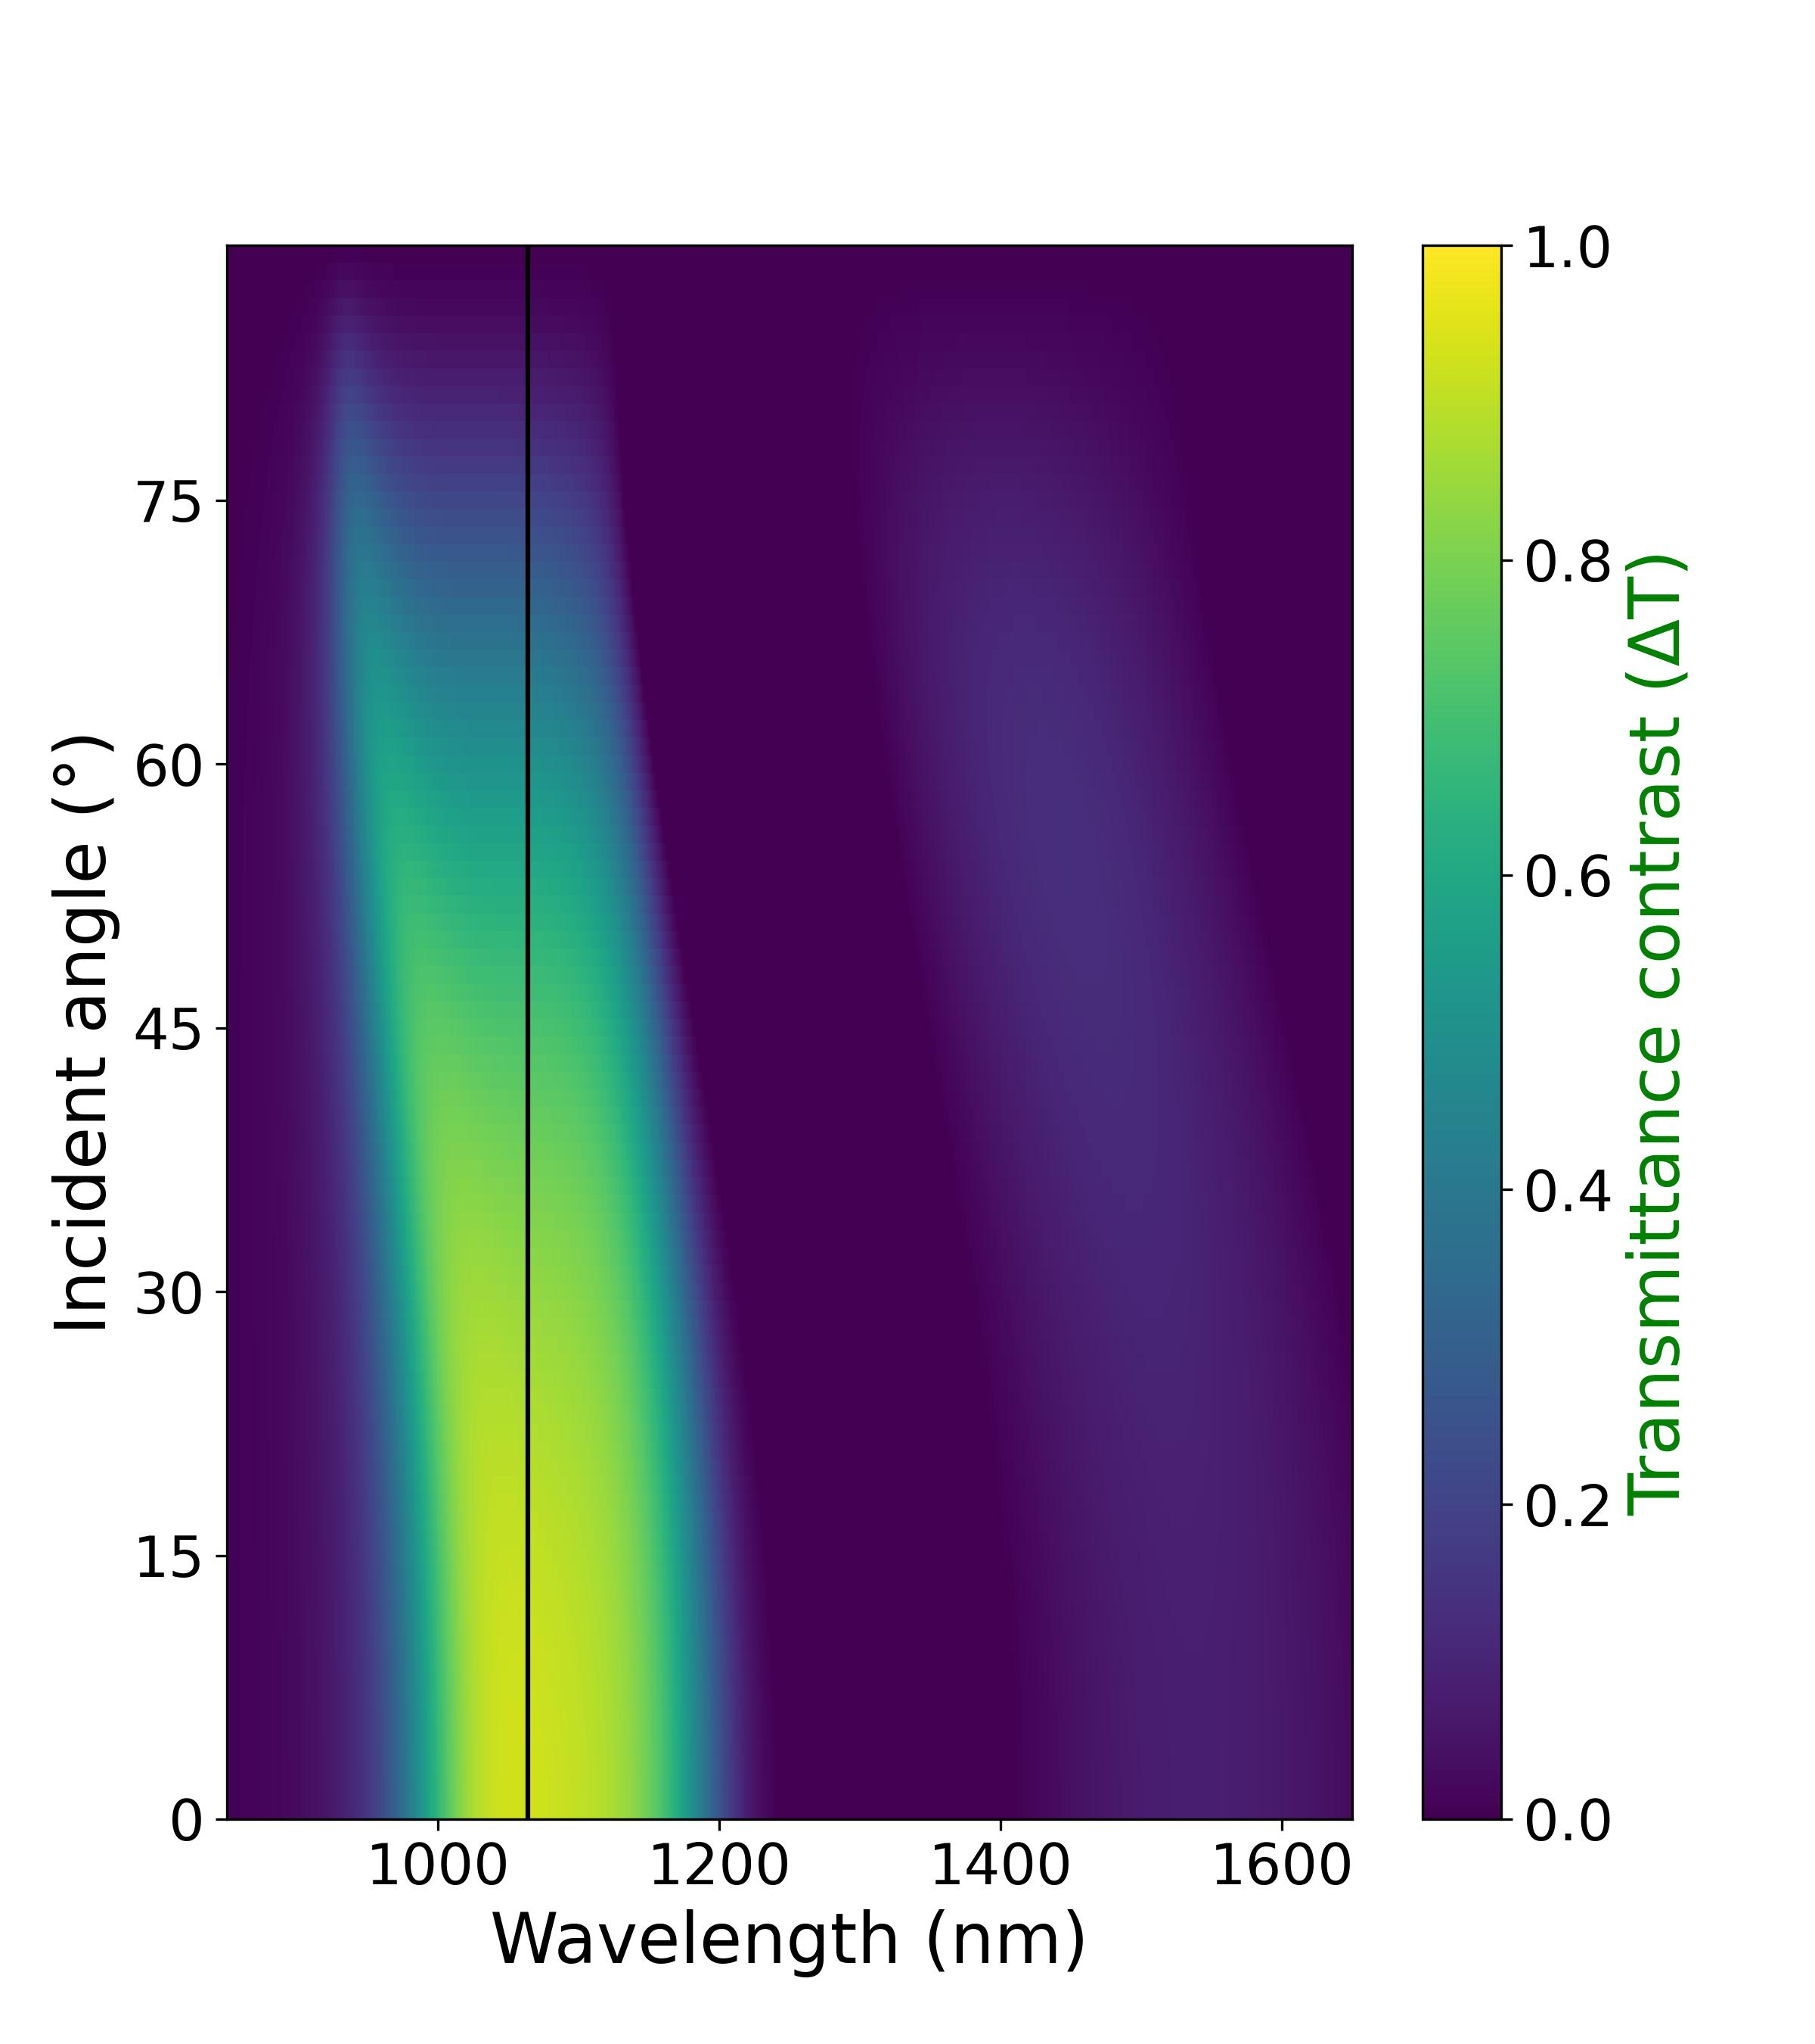
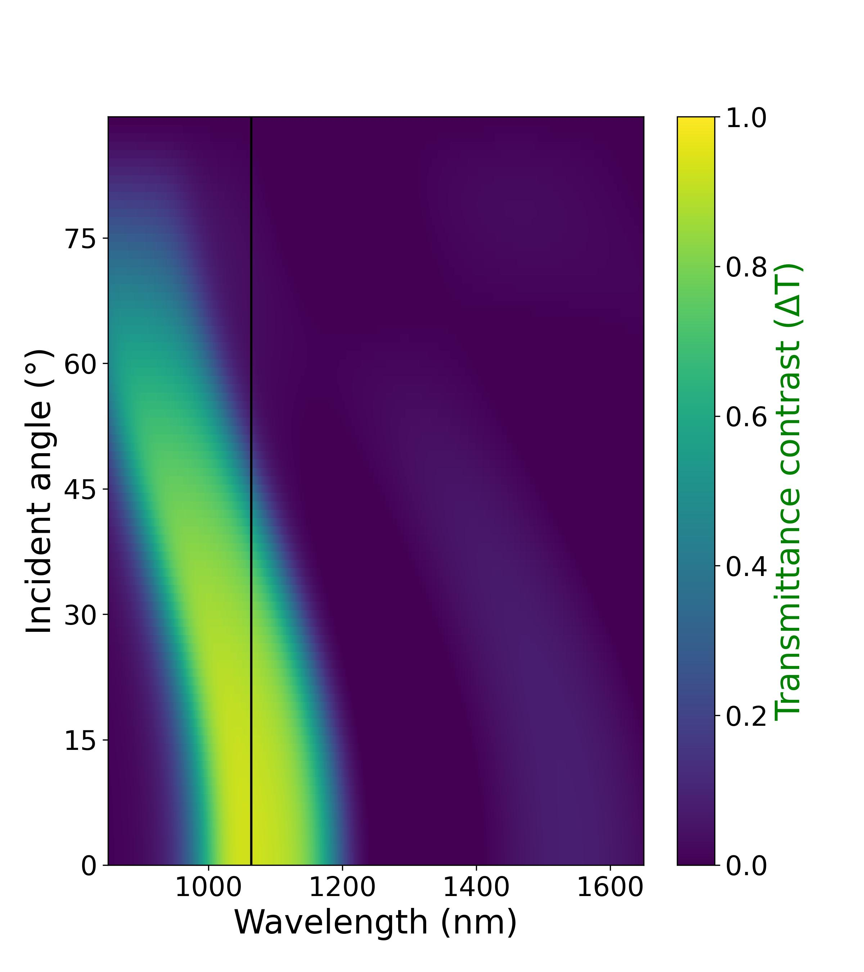
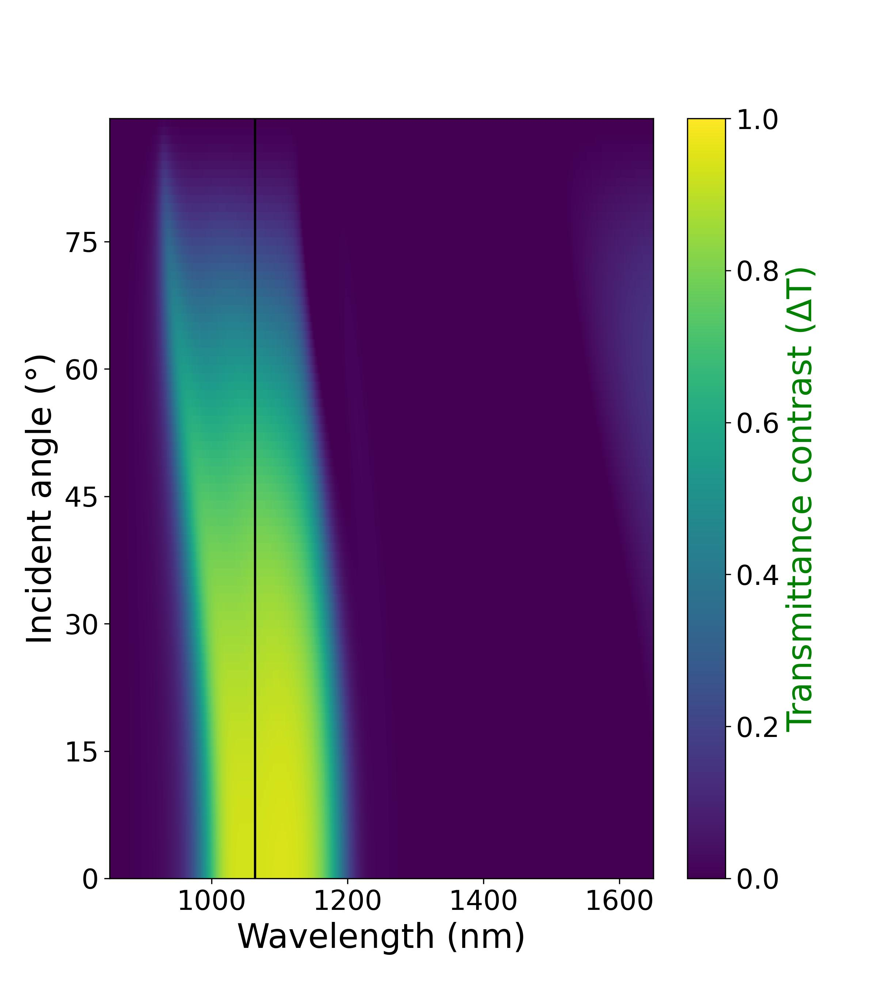
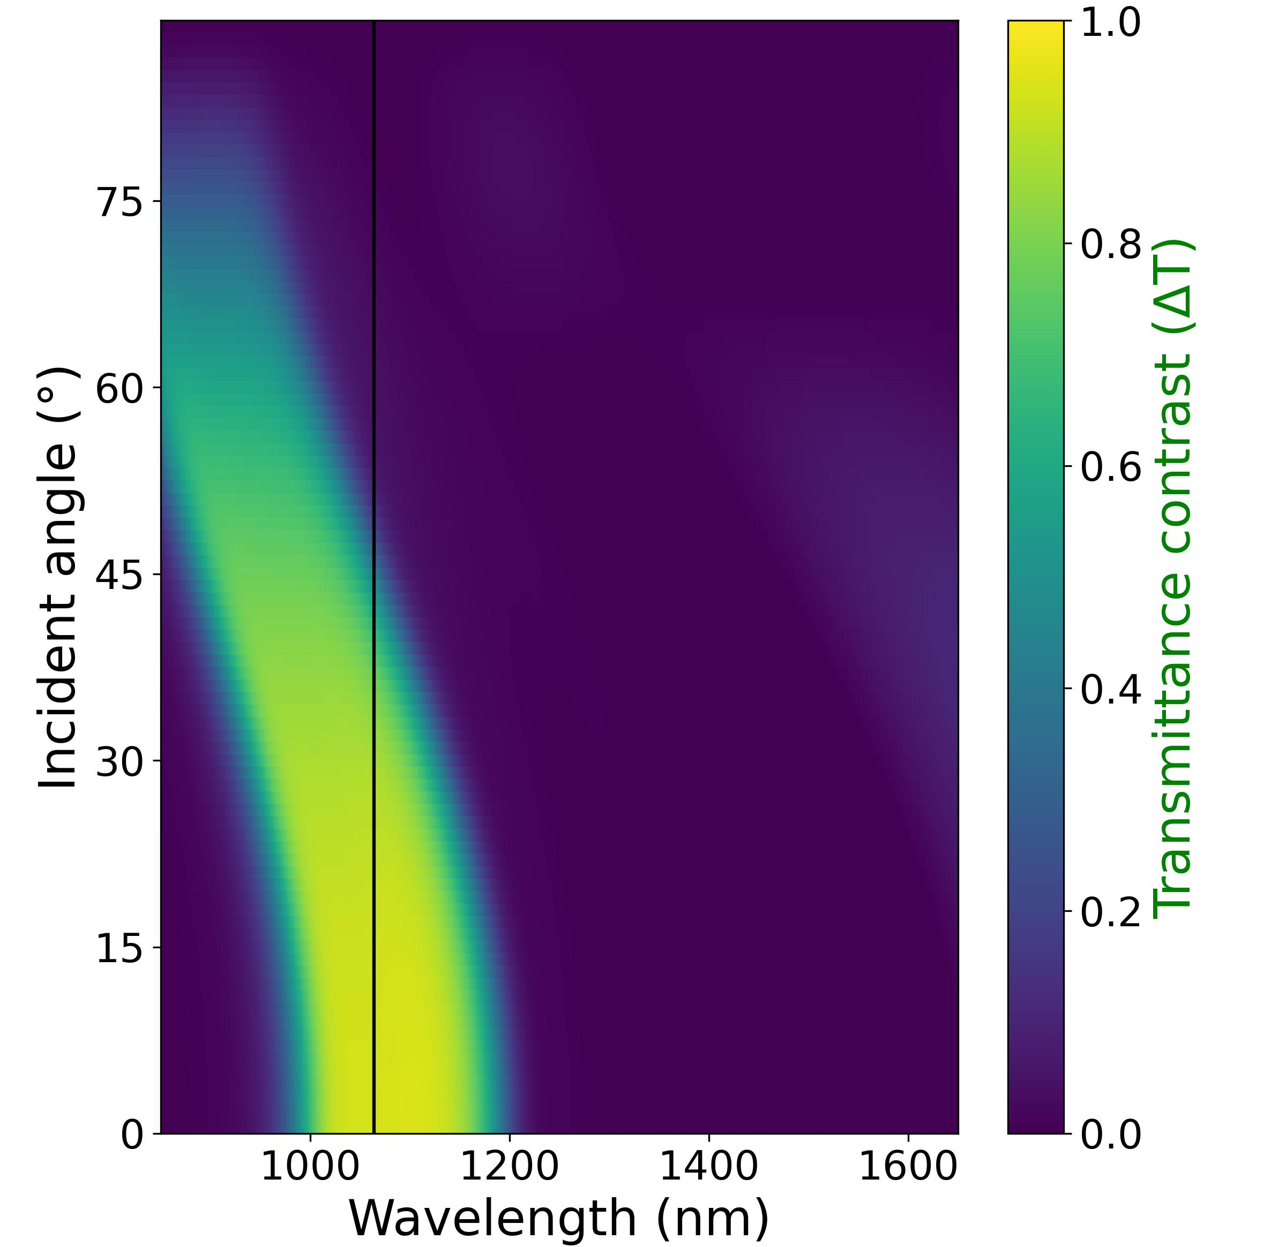
TE
TM
4-unit-cell design
(a)
(b)
5-unit-cell design
(c)
(d)

Slide 9
4-unit-cell design
5-unit-cell design

Slide 10


Single-layer design
Edge-filter design $(N=4)$
Edge-filter design $(N=5)$
(a)
(b)
(c)
(d)
(e)
(f)
(g)
(h)
(i)
Notes:
Fig. 9

Slide 11
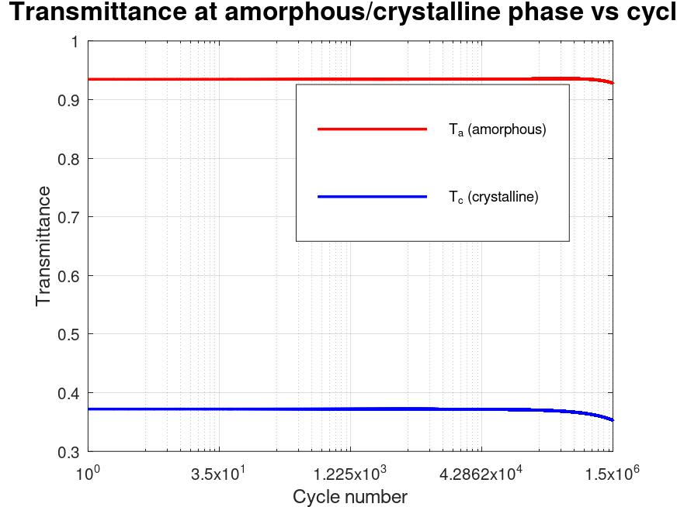
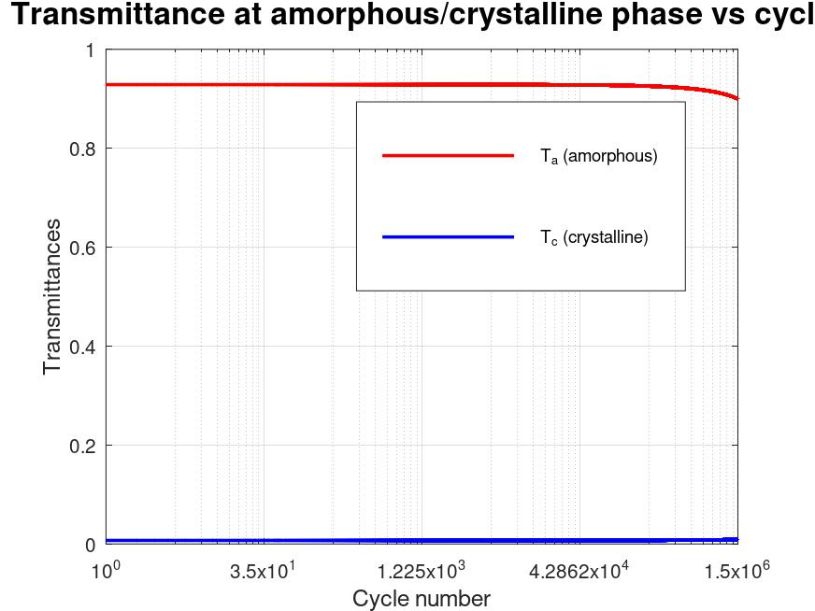
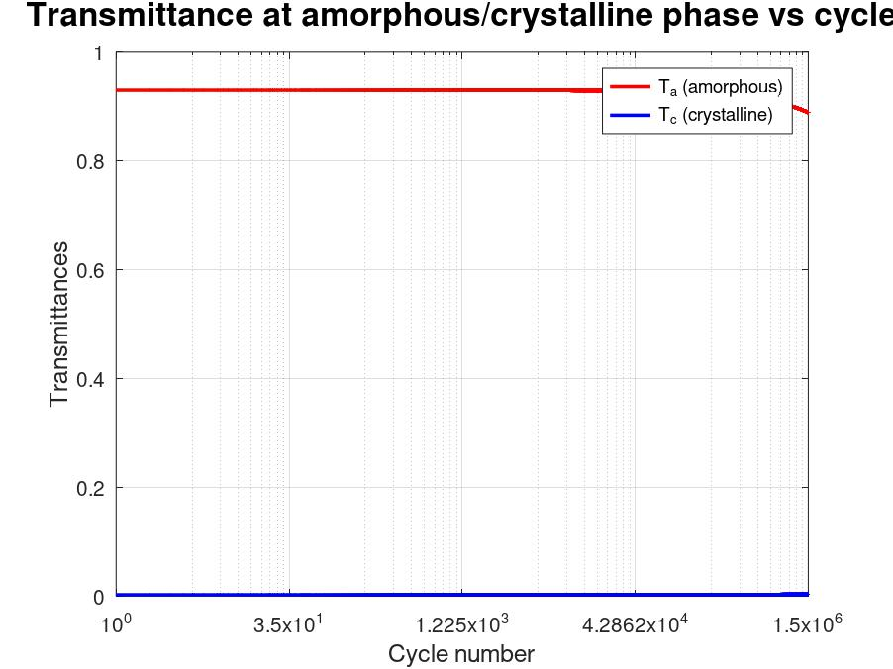
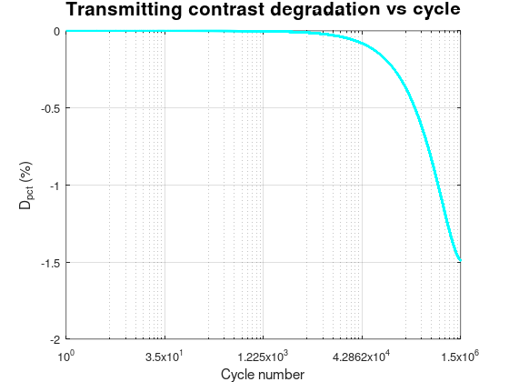
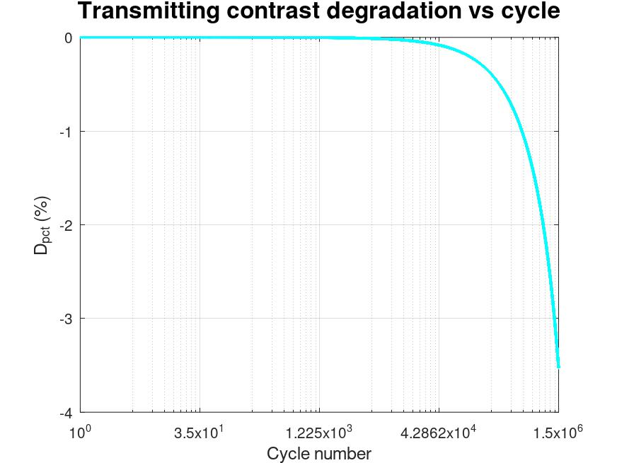
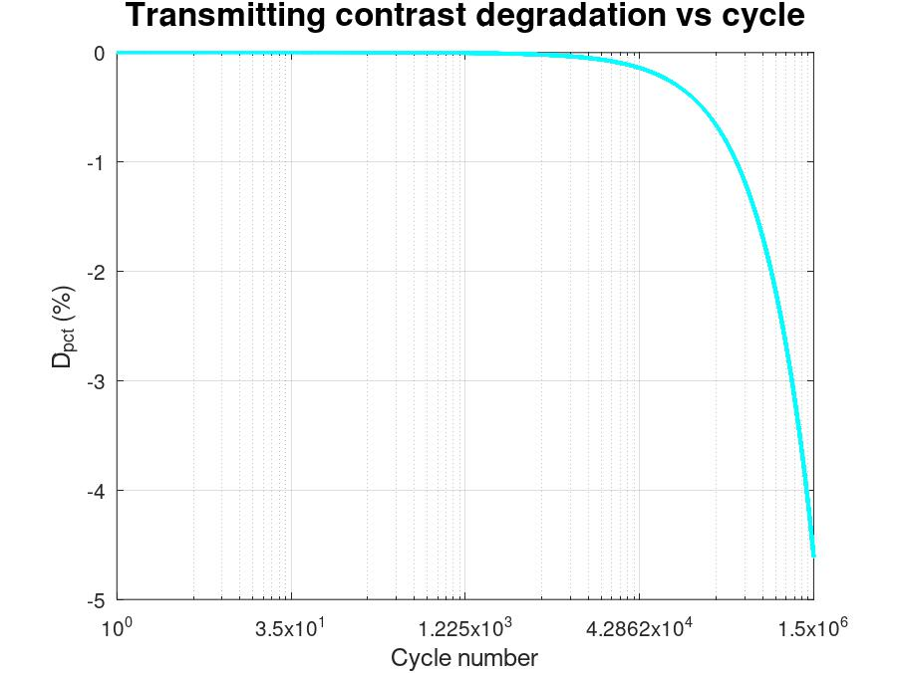
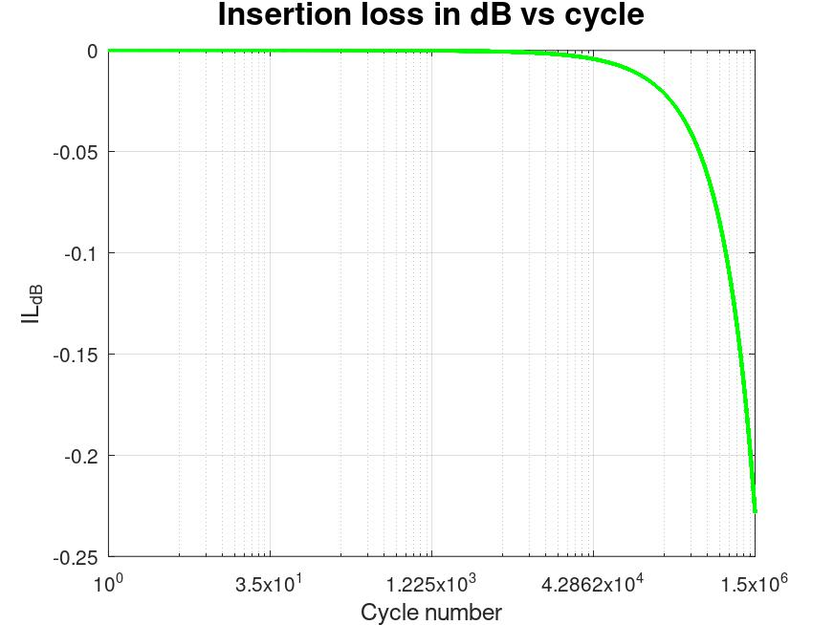
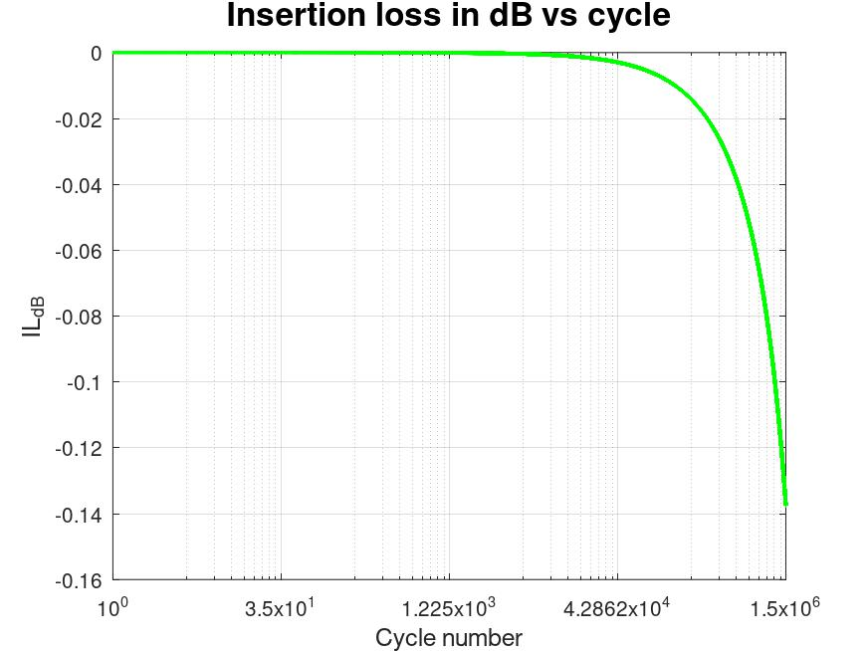
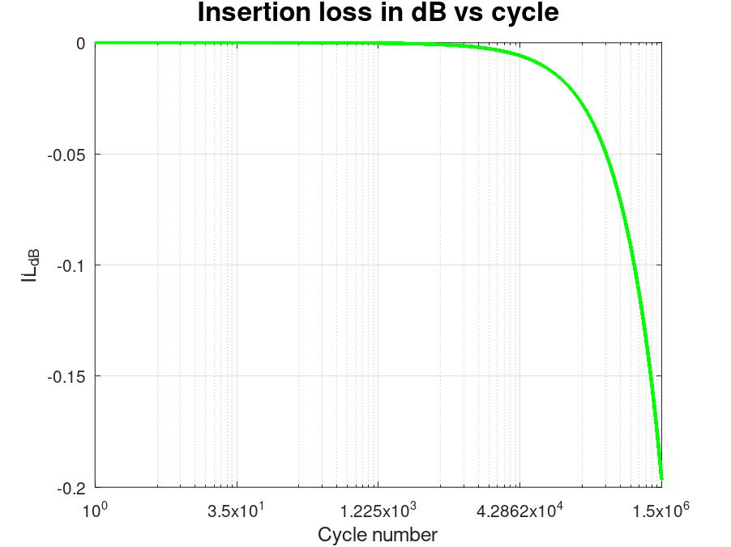


Single-layer design
Edge-filter design $(N=4)$
Edge-filter design $(N=5)$
Transmittance
Transmittance
Transmittance
Cycle number
Cycle number
Cycle number
(a)
(b)
(c)
D_{pct} (%)
D_{pct} (%)
D_{pct} (%)
Cycle number
Cycle number
Cycle number
(d)
(e)
(f)
IL (dB)
IL (dB)
IL (dB)
Cycle number
Cycle number
Cycle number
(g)
(h)
(i)
Notes:
Old one from 1st submission

Slide 12

Single-layer design
Edge-filter design $(N=5)$
(a)
(b)
Transmittance
Transmittance
Cycle number
Cycle number
(c)
(d)
D_{pct} (%)
D_{pct} (%)
Cycle number
Cycle number
(e)
(f)
IL (dB)
IL (dB)
Cycle number
Cycle number

Slide 13
(a)
(b)
(c)
(d)

Slide 14
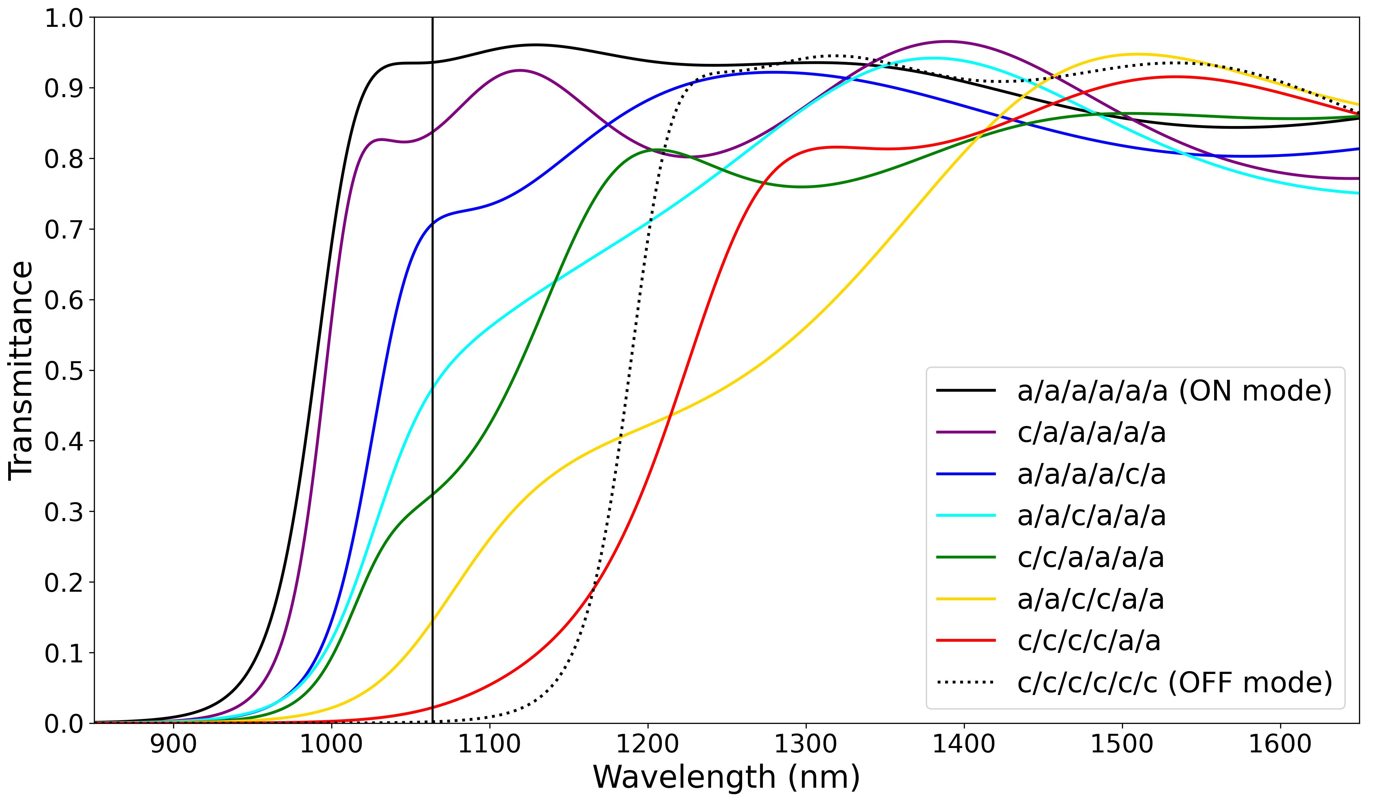
Notes:
Fig. 11

Slide 15
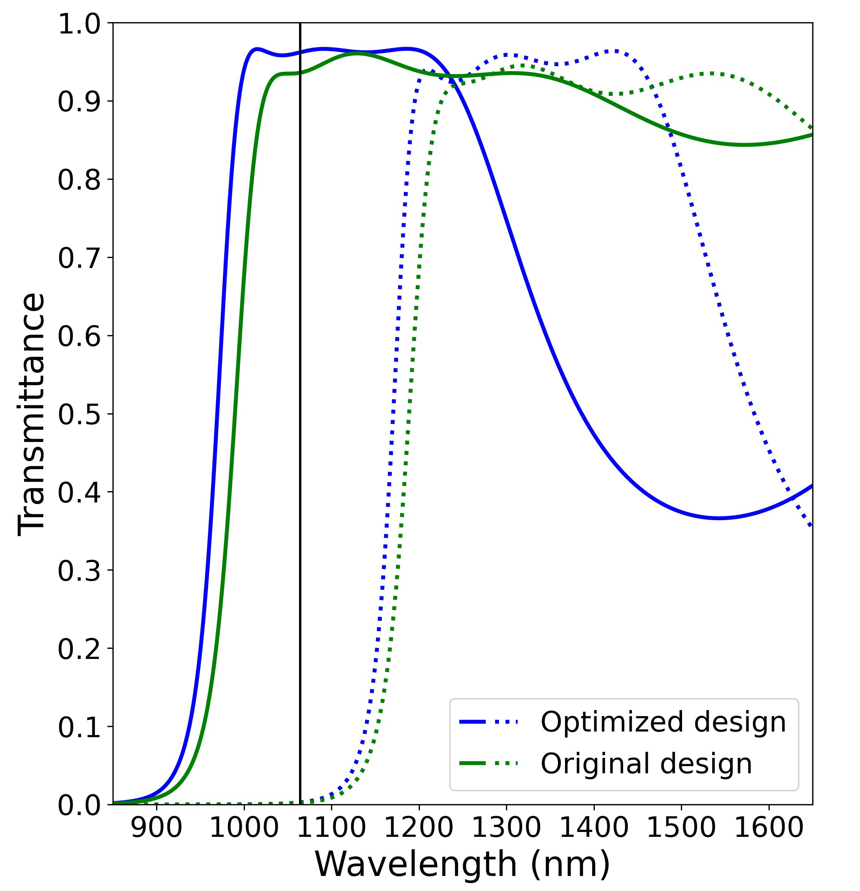
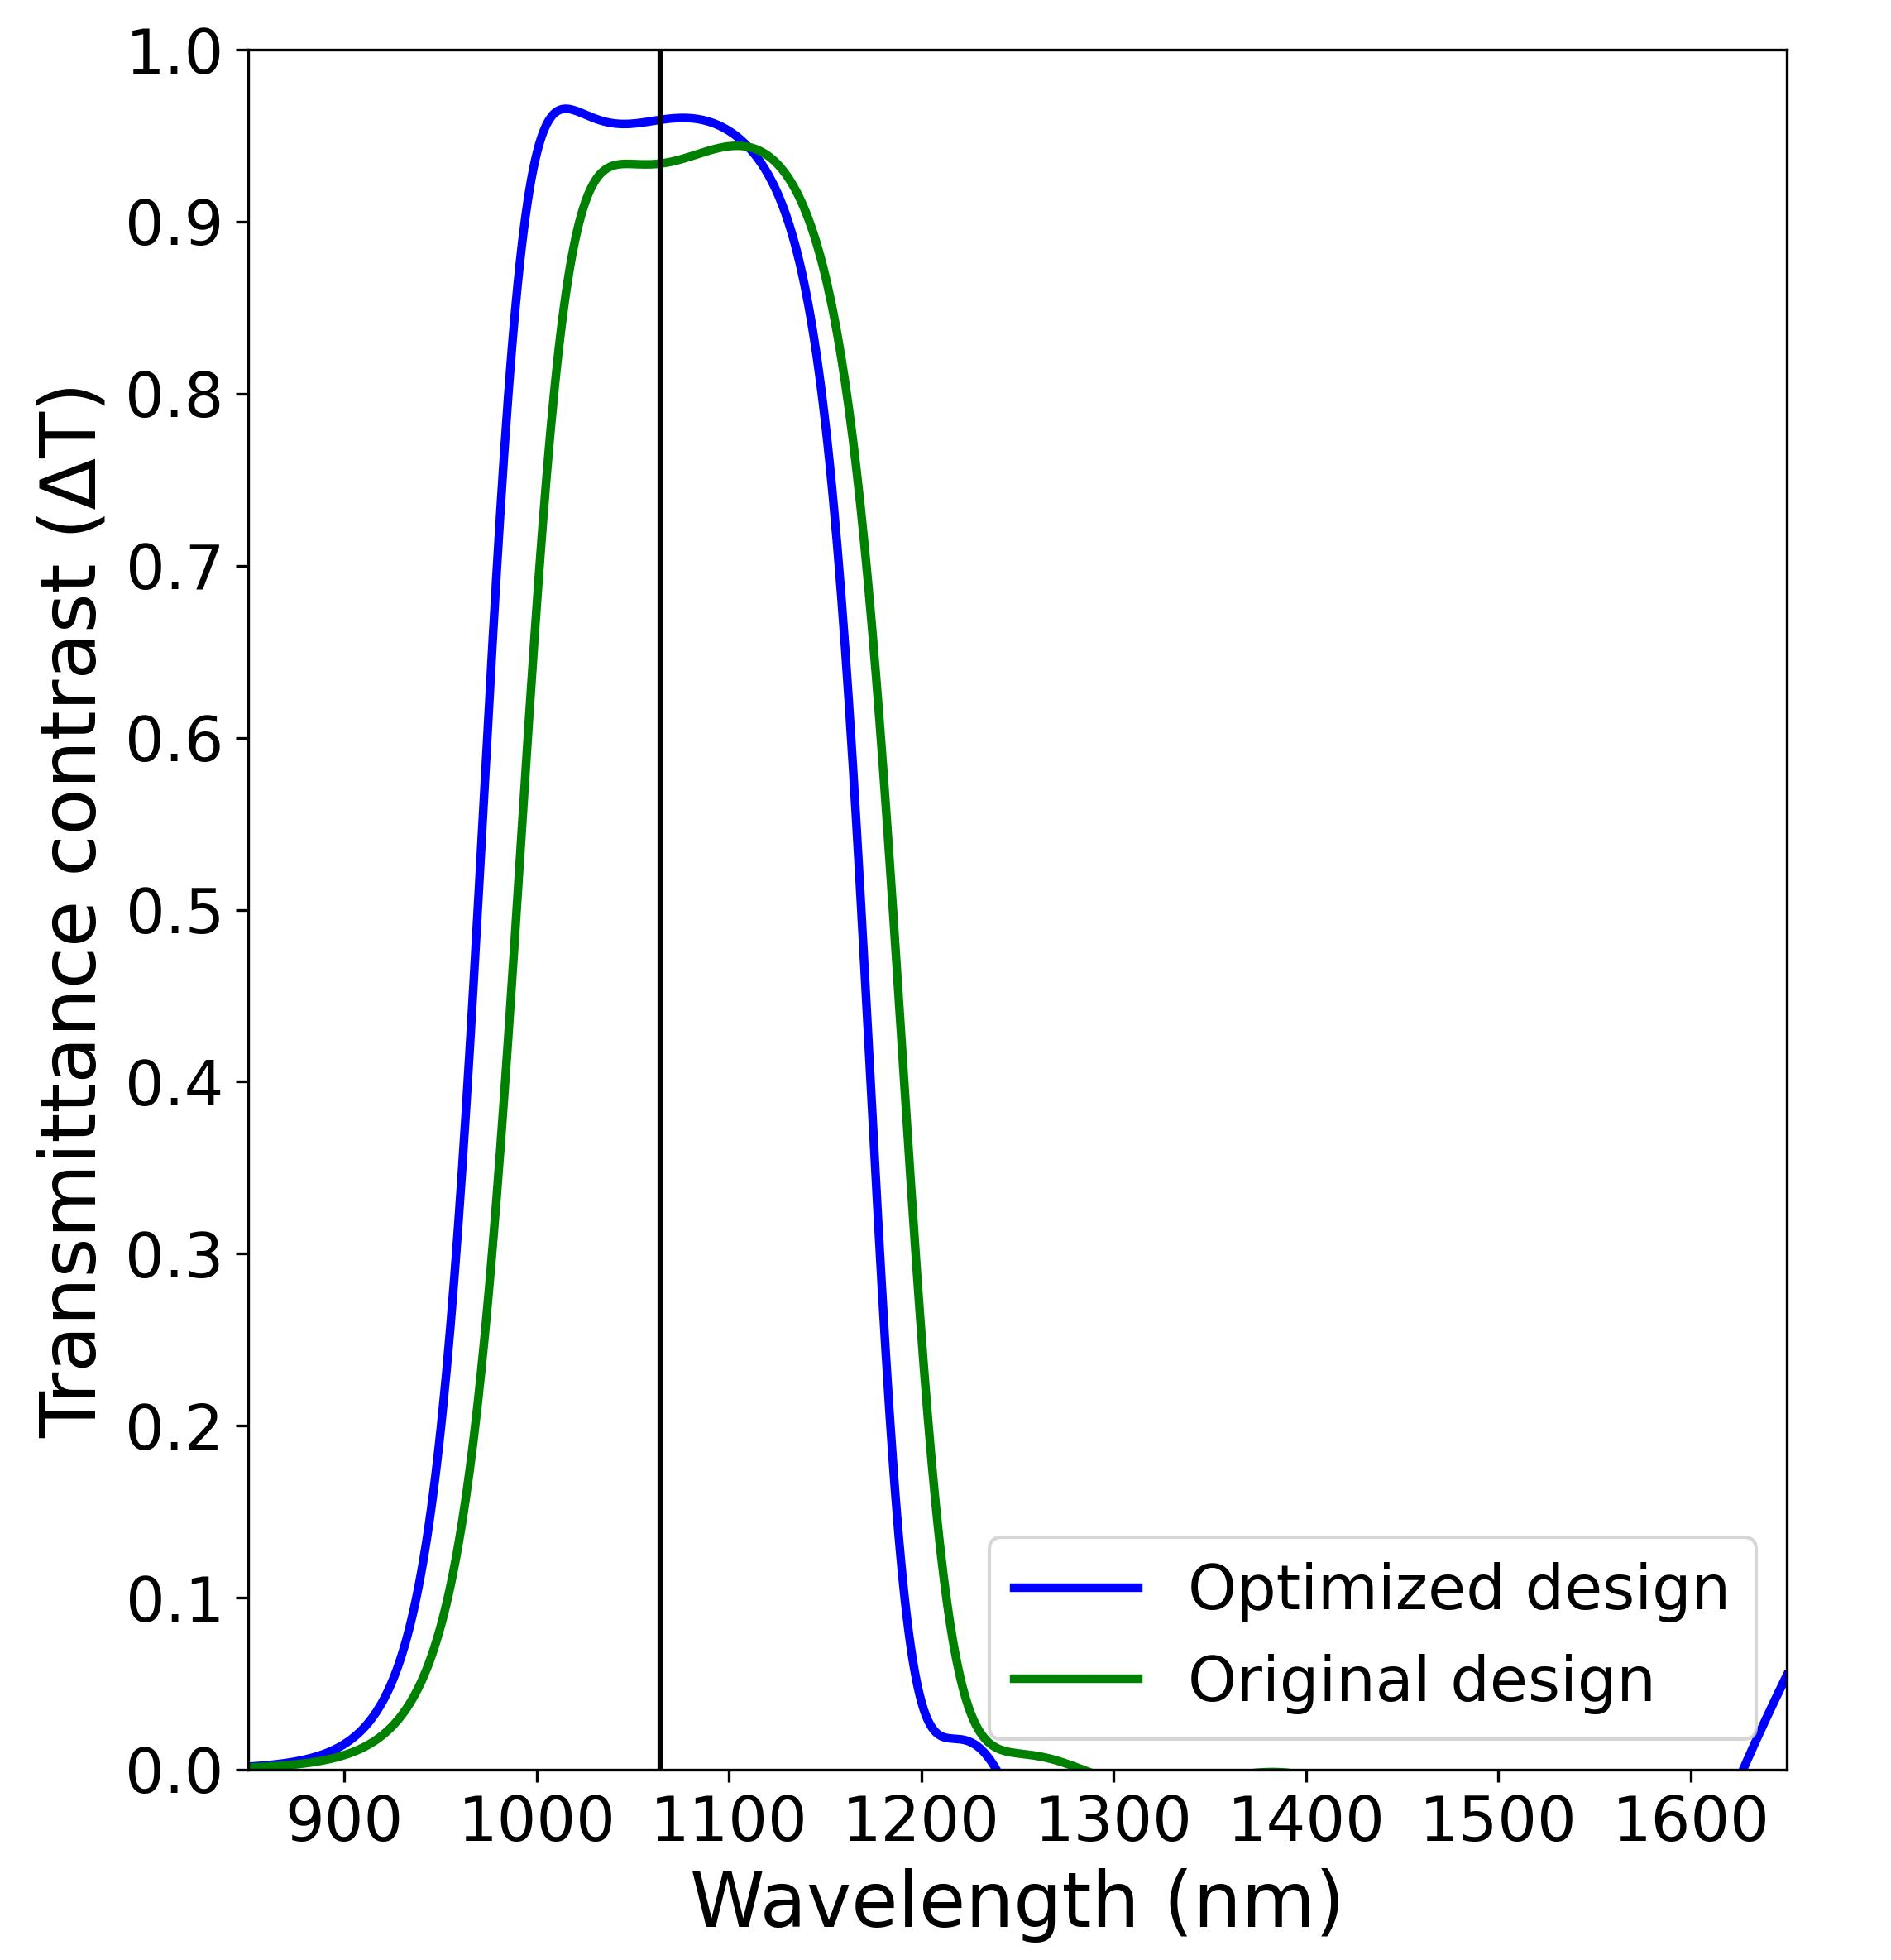
(a)
(b)
Notes:
Fig. 12

Slide 16
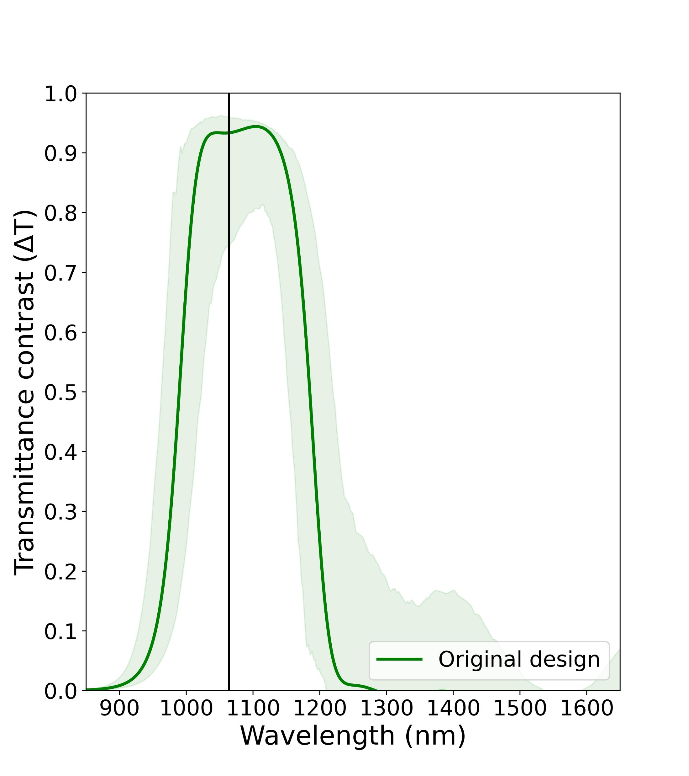
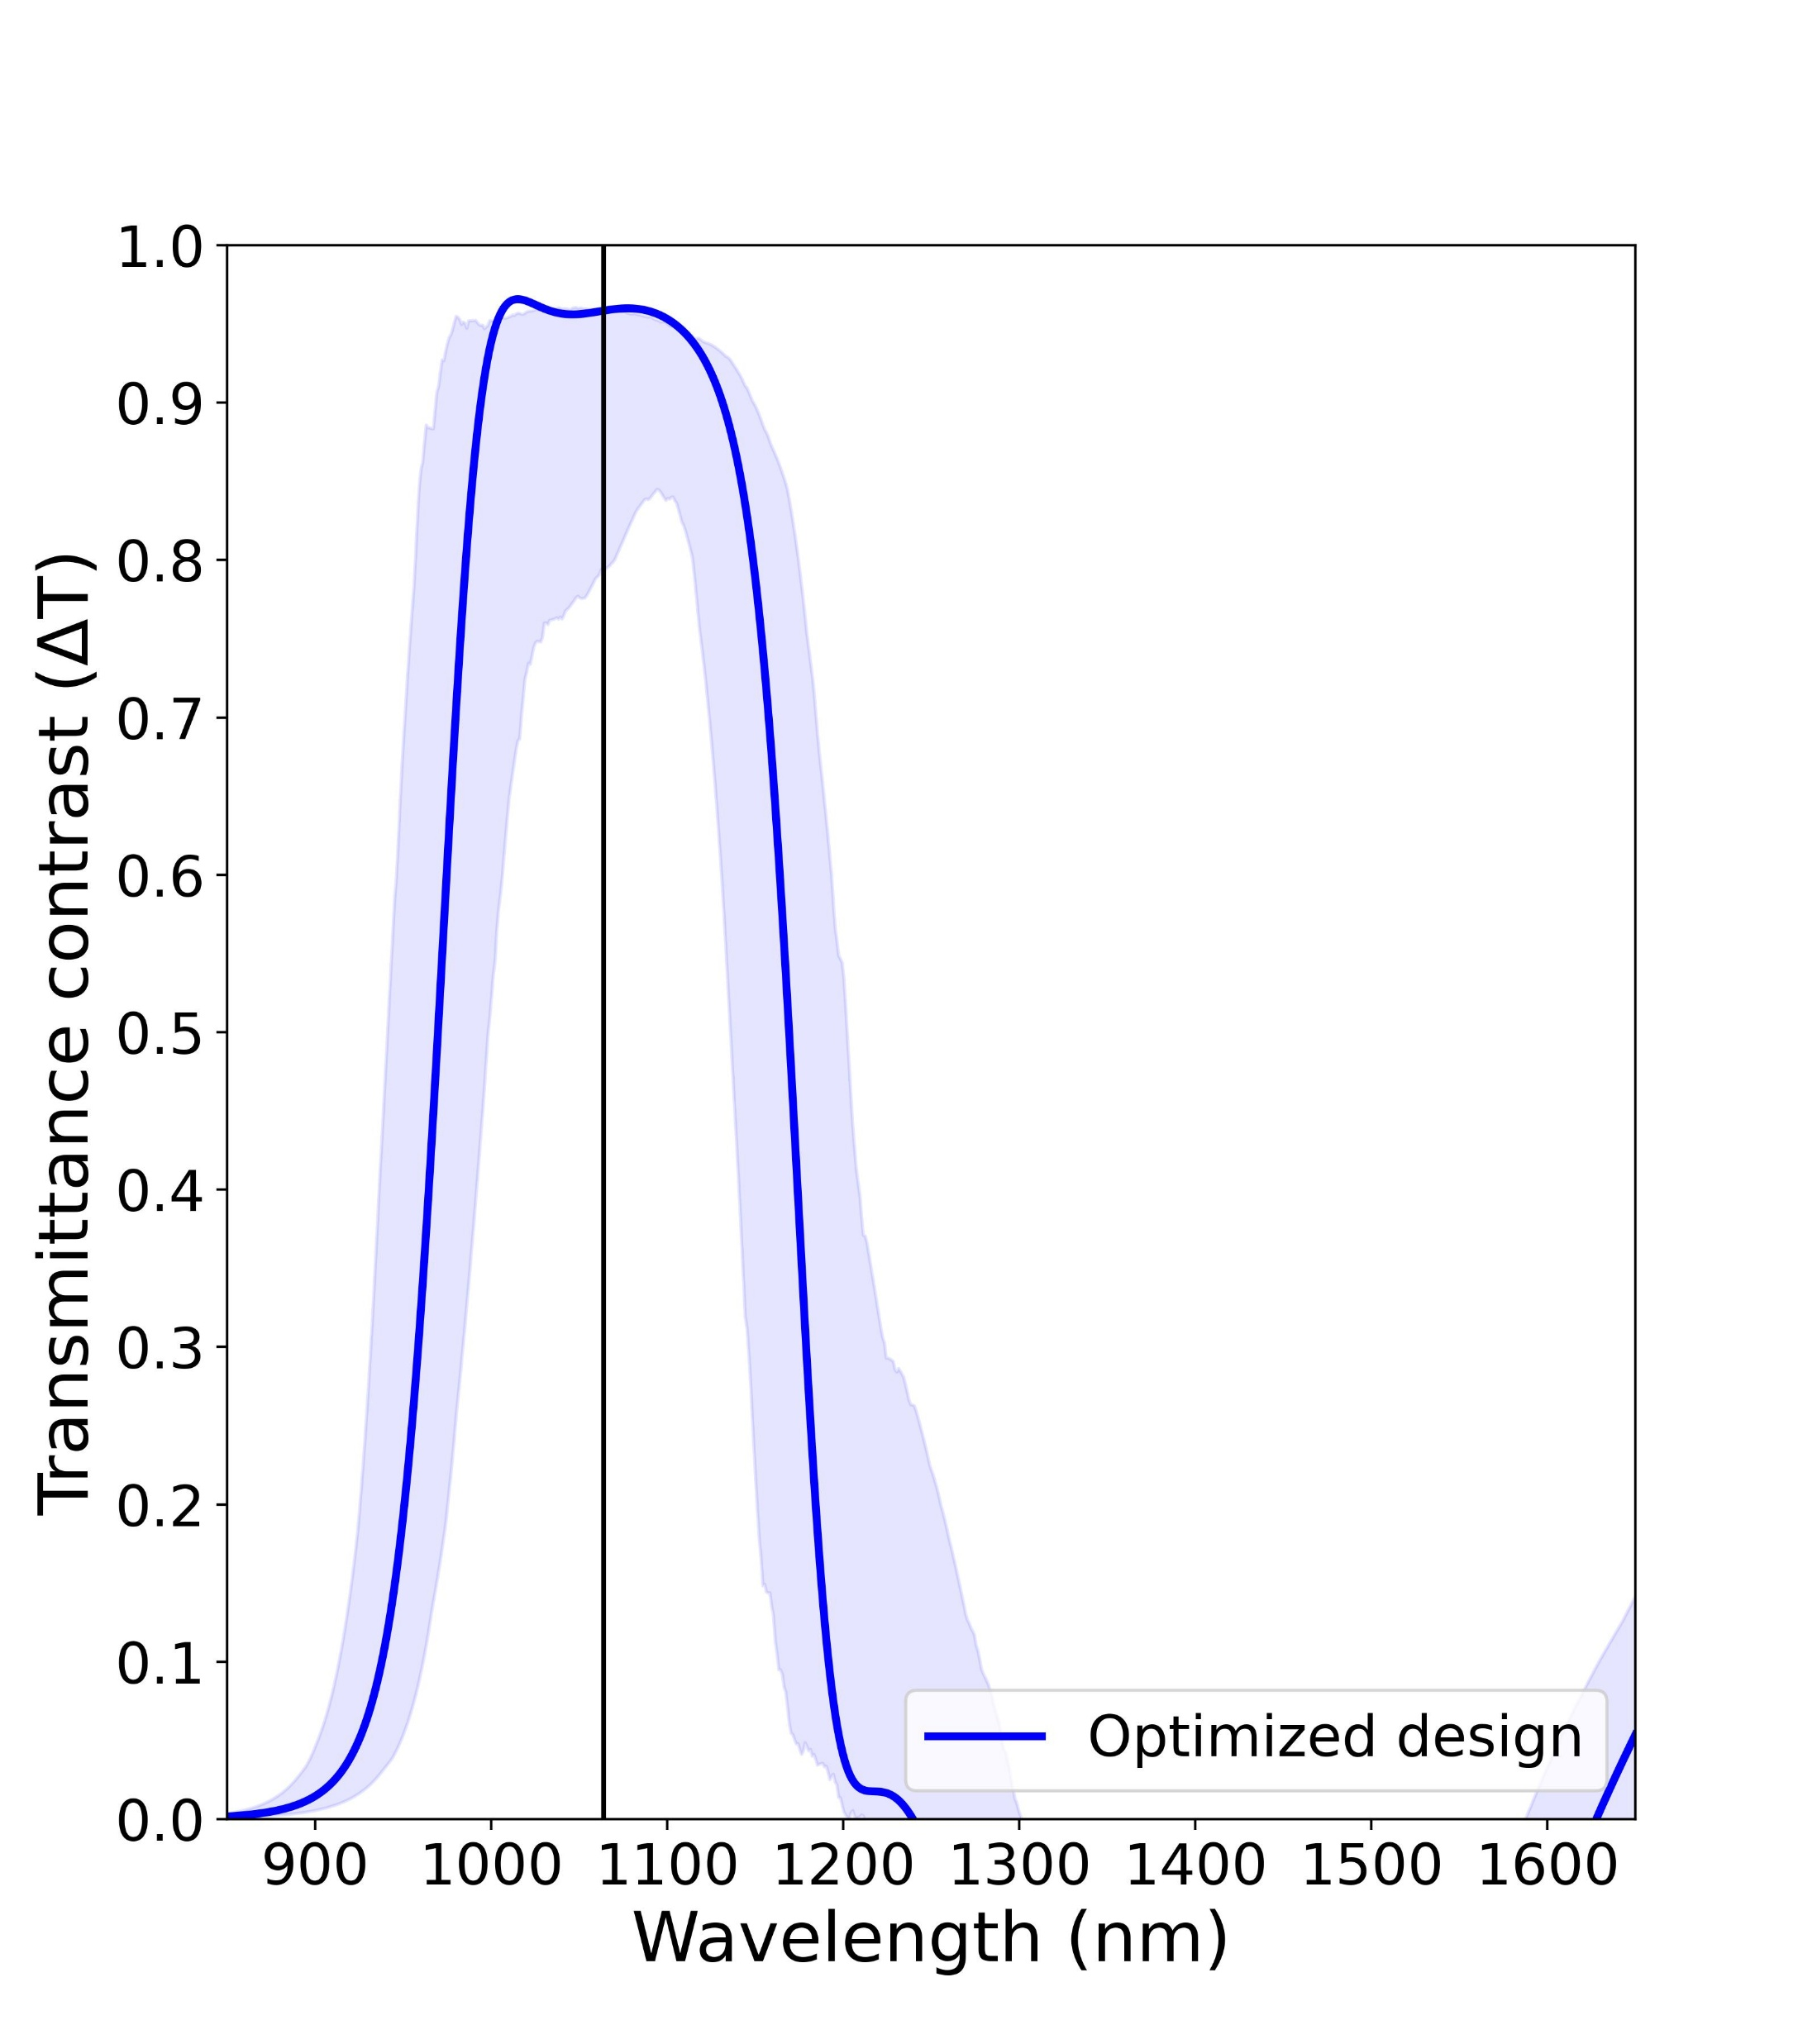
(a)
(b)
Notes:
Fig. 13

Slide 17
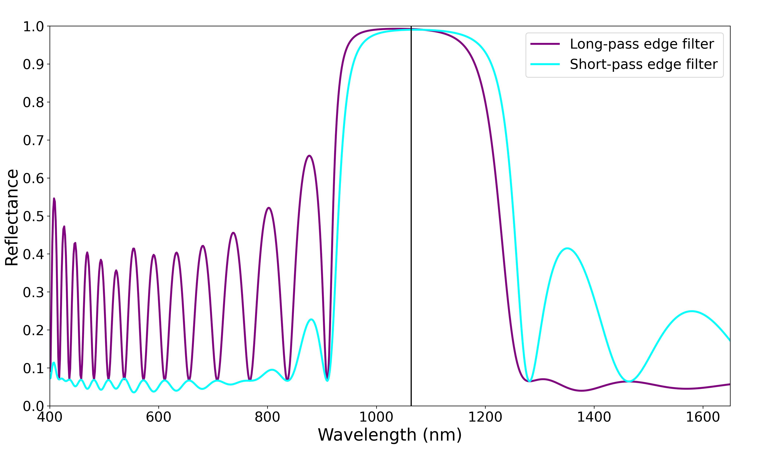
High reflection region
Stable AR-region
Stable AR-region

Slide 18
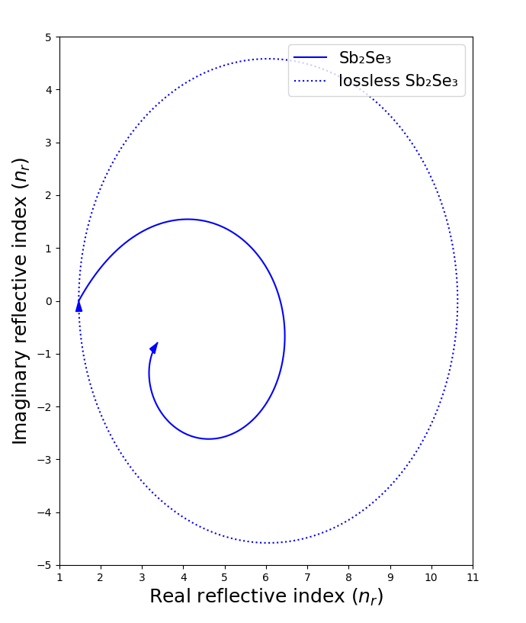
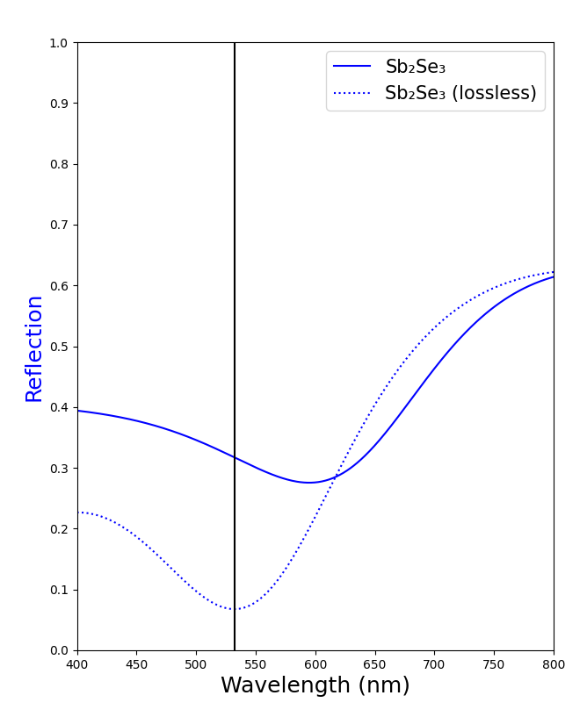
(a)
(b)

Slide 19
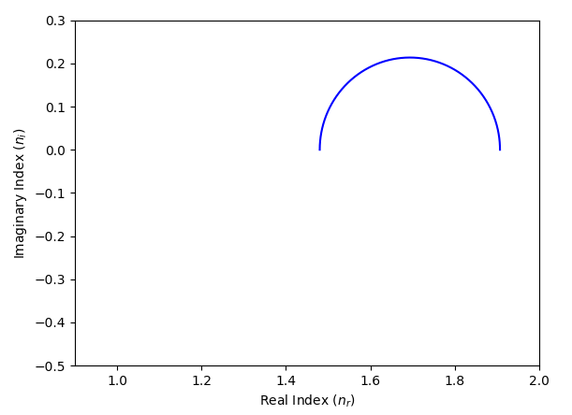
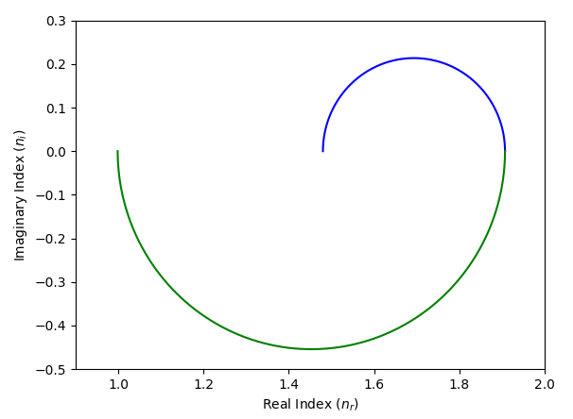
(a)
(b)
n_{r}=n_{a}=1.0
n_{s}=1.5

Slide 20
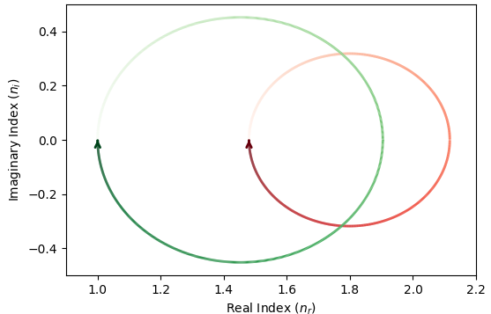

Slide 21
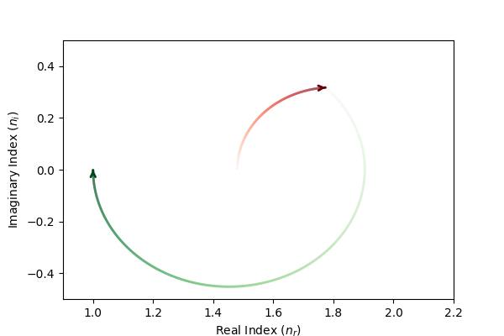
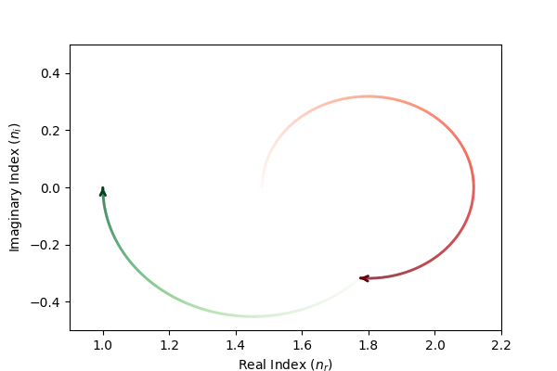
(a)
θ = 0.53 QWOT
(b)
θ = 1.18 QWOT
θ = 0.82 QWOT
θ = 1.47 QWOT

Slide 22
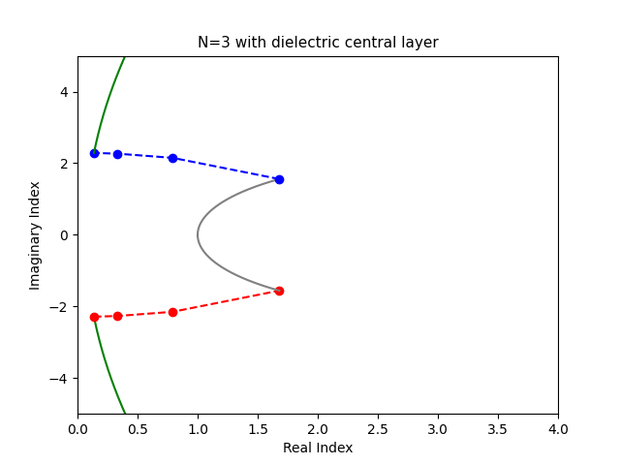
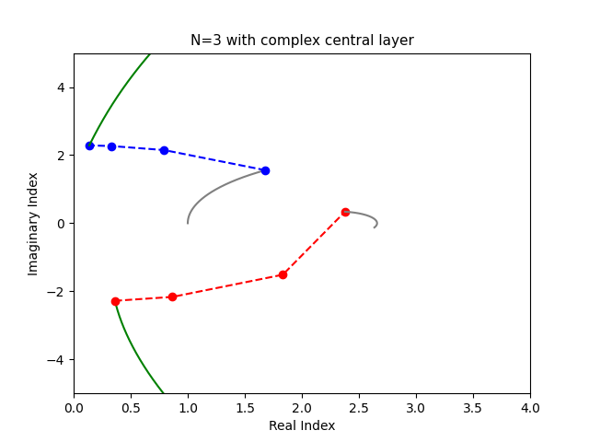
(a)
(b)

Slide 23
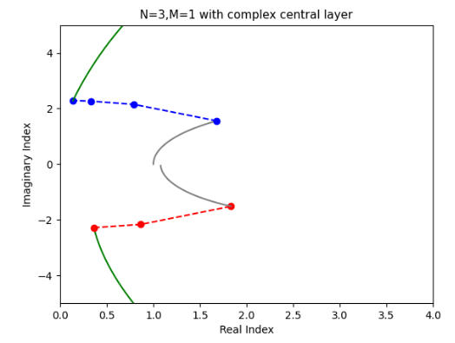

Slide 24

Compensator layer

Slide 25
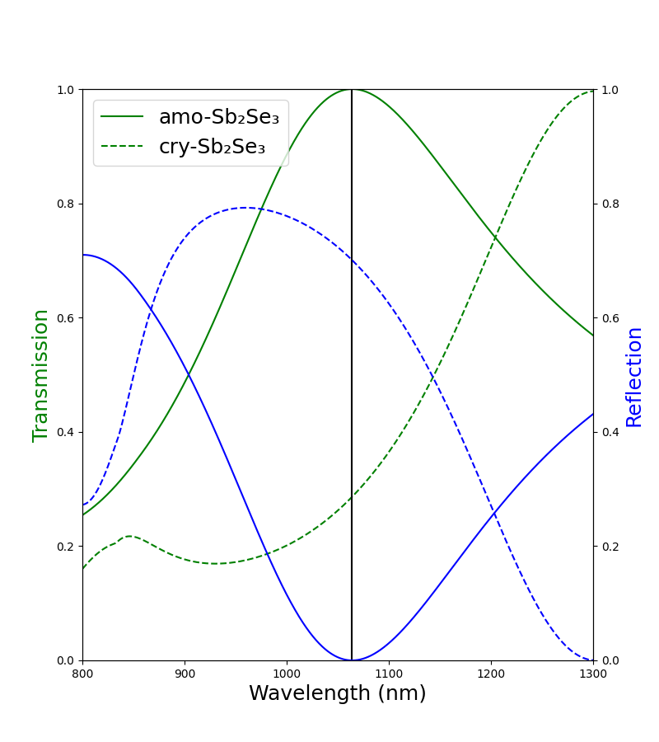
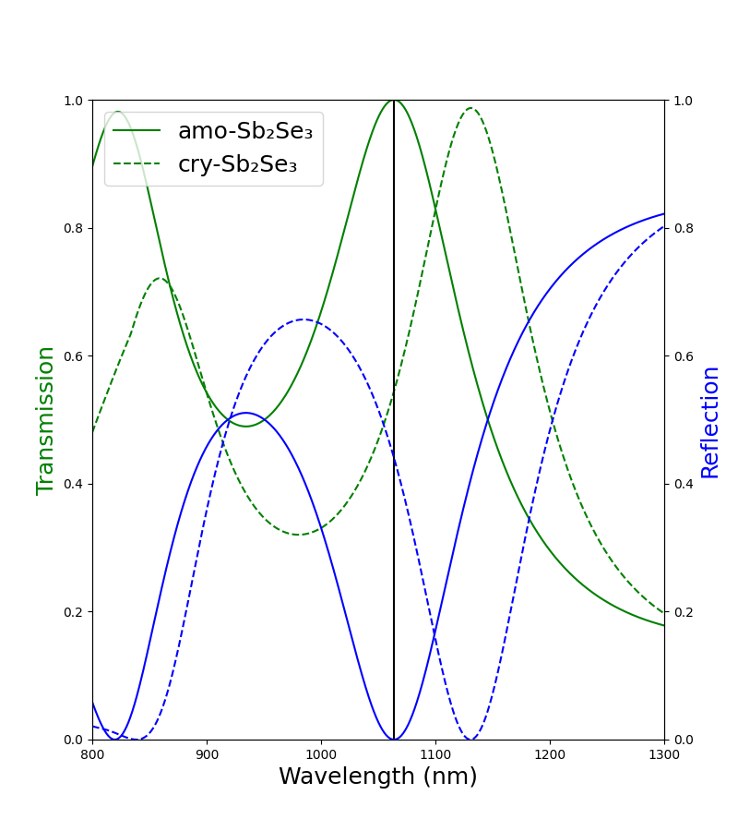
(a)
(b)

Slide 26
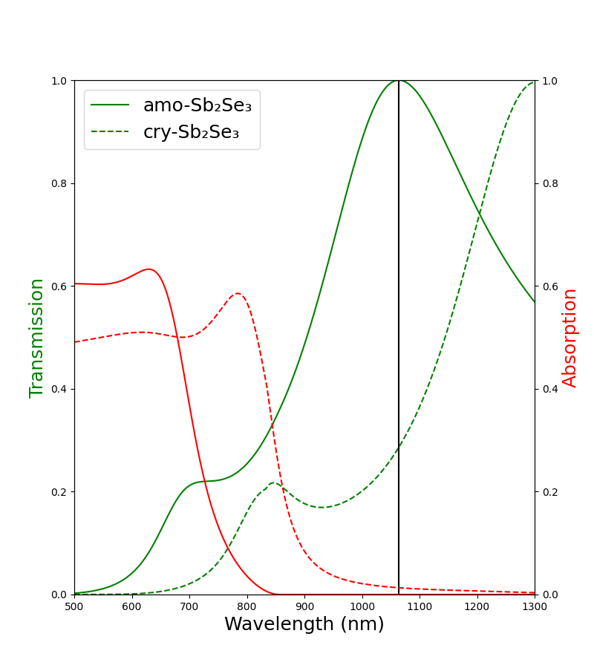
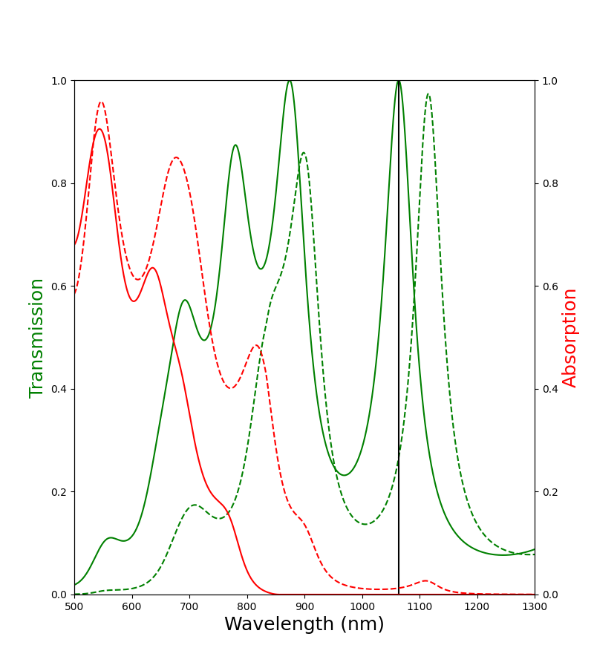
(a)
(b)

Slide 27
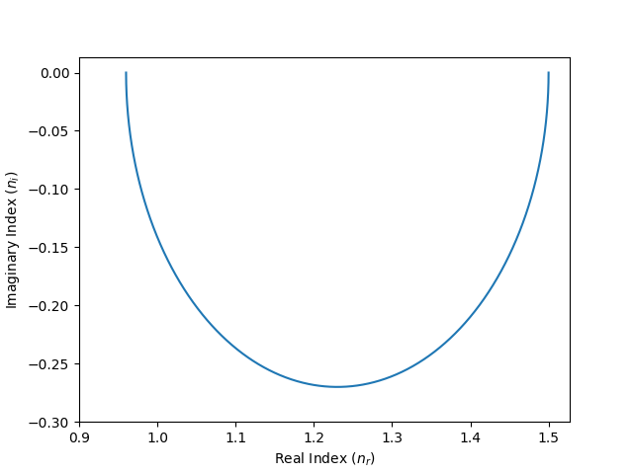
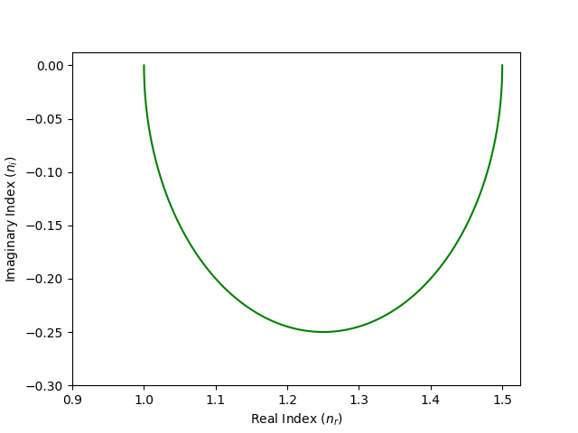
θ = π/2
n_{r} = 0.96
θ = 0
n_{r} = 1.5
θ = π/2
n_{r} = 1.00
θ = 0
n_{r} = 1.5
(a) (b)

